Slide 1
Mr. H.L. de Vries, head of National Cyber Security Centre

Slide 2
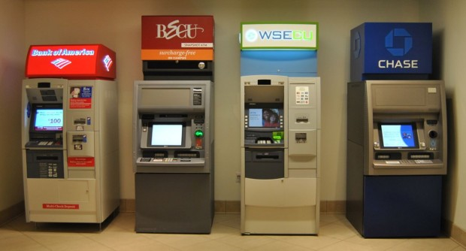

Slide 3
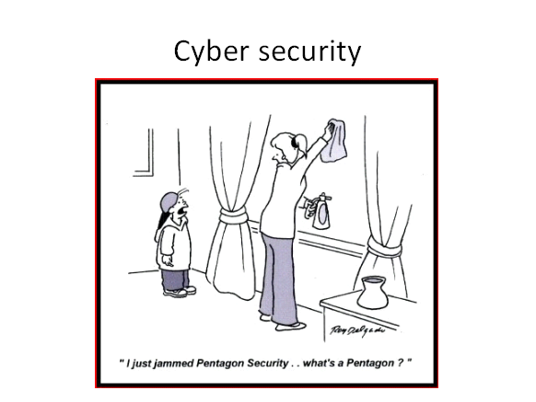
Software vulnerabilities achilles heel

Slide 4


Slide 5




Slide 6
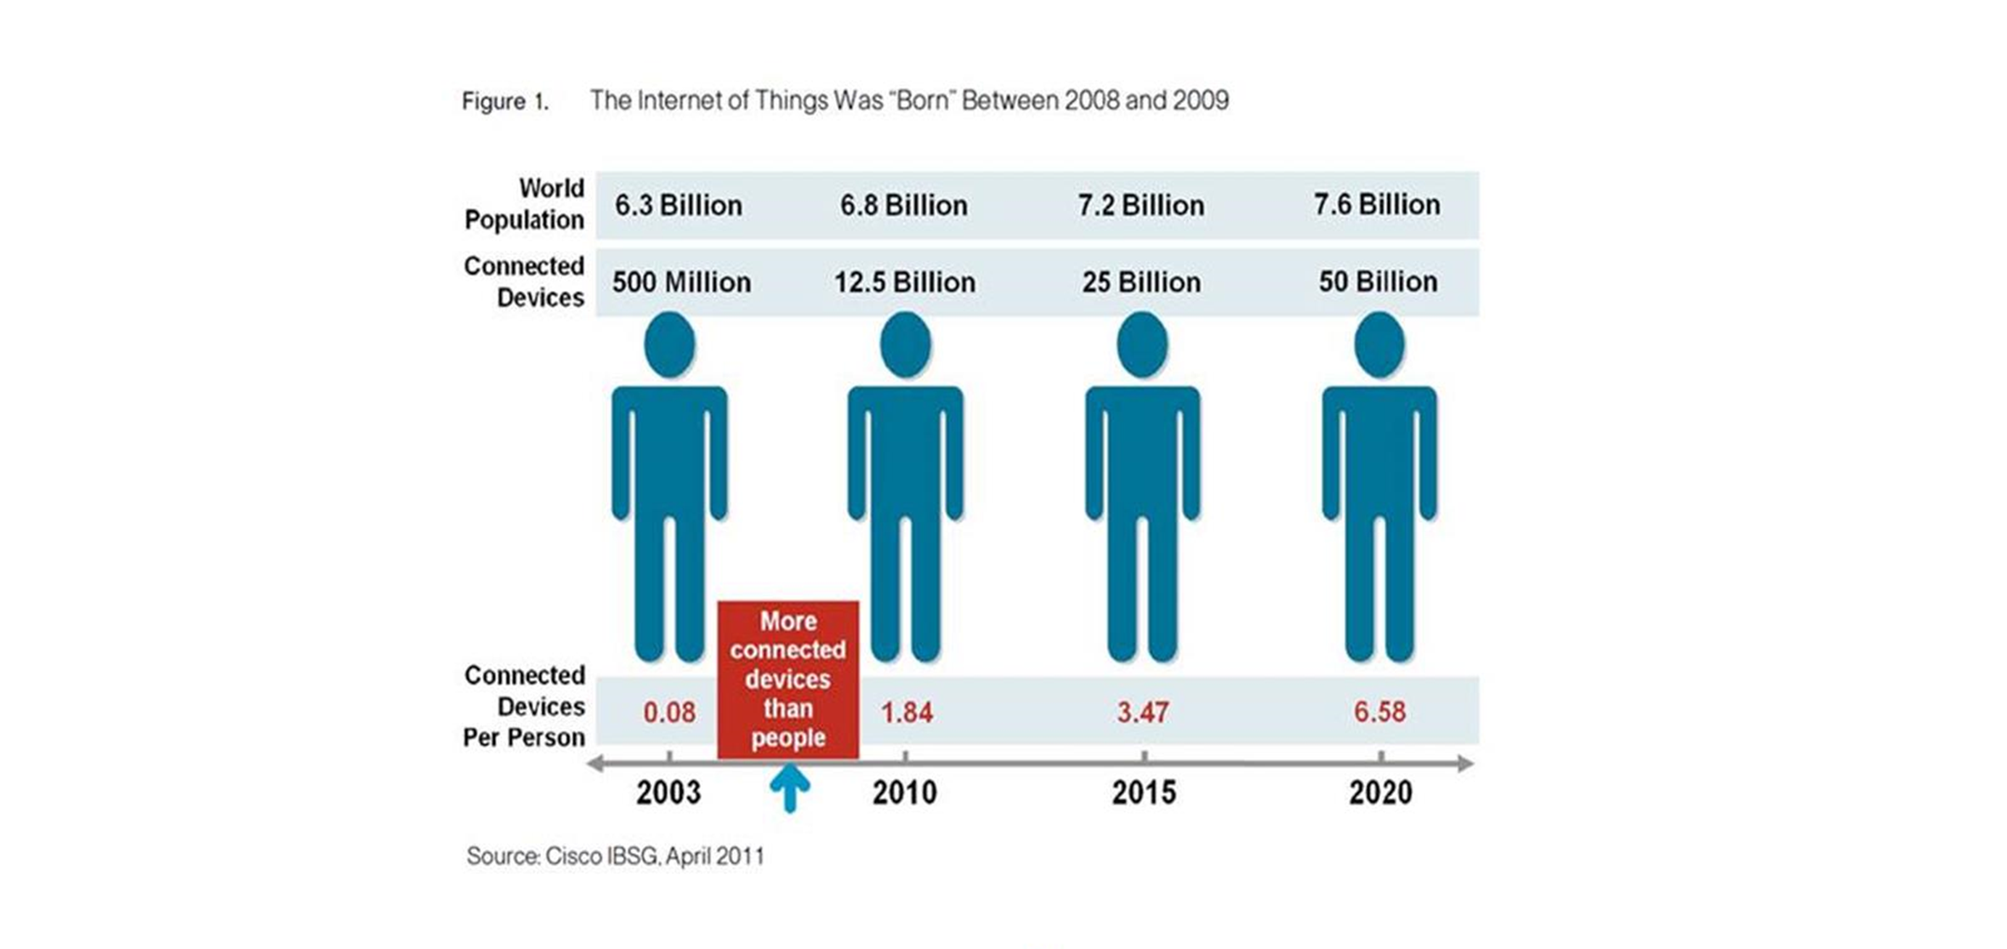

Slide 7

Example: vulnerabilities in modems solved

Slide 8

Responsible disclosure
=
Helpende hackers
Coordinated Vulnerability
Disclosure

Slide 9

IoT kettle

Slide 10


