Slide 1
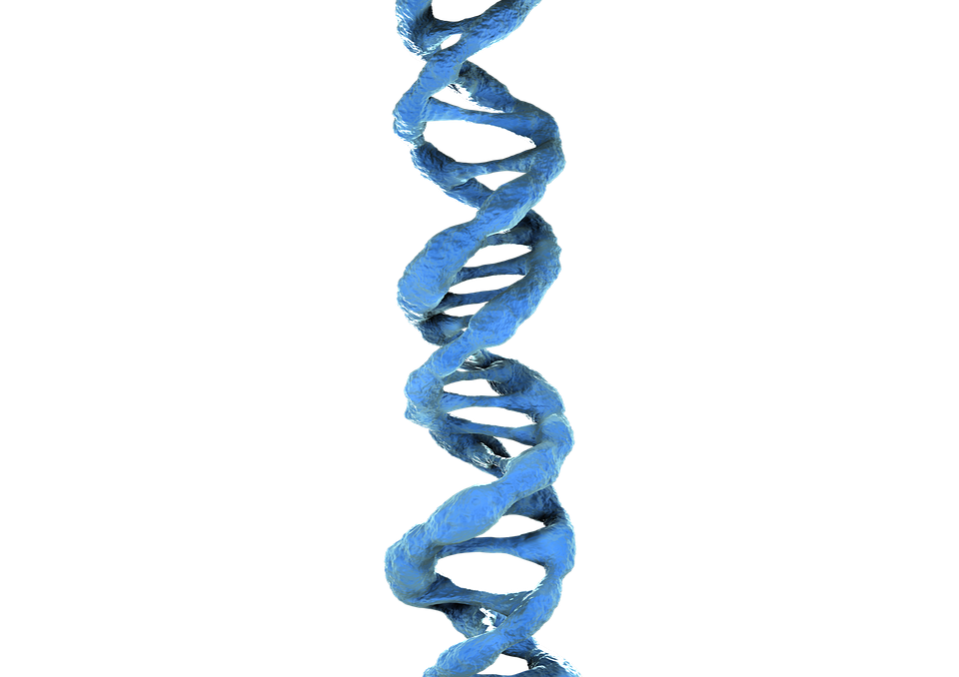
How biohacking and implants can improve your life.
Talk by: Patrick Paumen

Slide 2
Introduction
Patrick Paumen
Founder of hackerspace ACKspace

Slide 3
Biohacking history

Slide 4
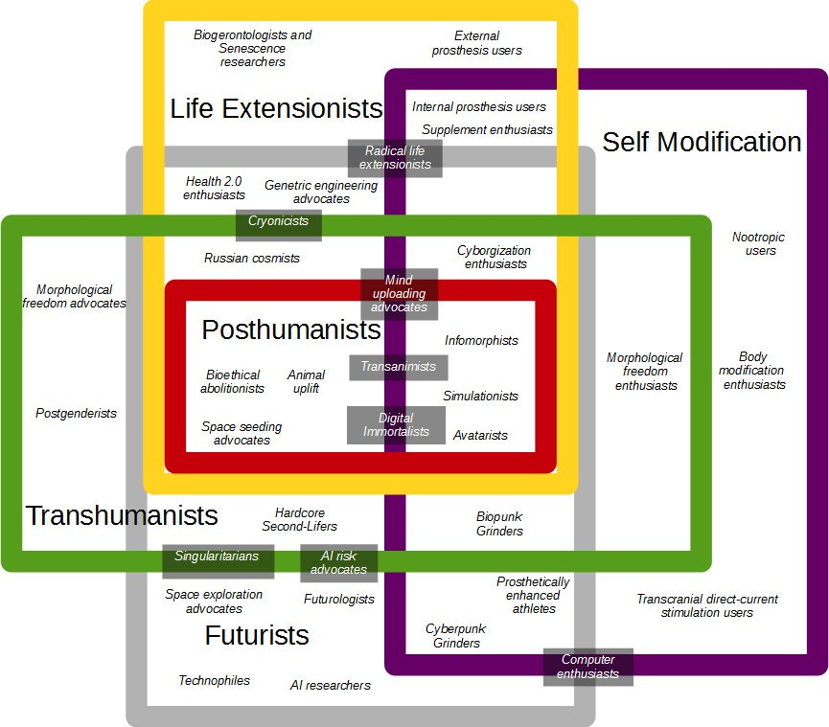
Philosophy of transhumanism

Slide 5
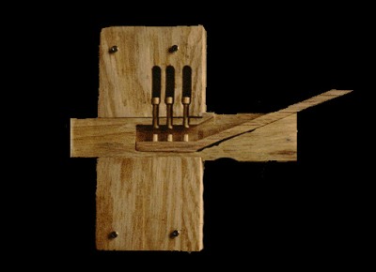
Disadvantages of mechanical keys and locks
Notes:
Mechanical locks and keys are ancient old technology, the oldest found lock is from Ancient Egypt, 400 BC. Keys can be forgotten, lost or stolen. When one key is lost, then the lock and all keys must be replaced to prevent unauthorized access. Replacing the lock and all keys can get expensive.

Slide 6
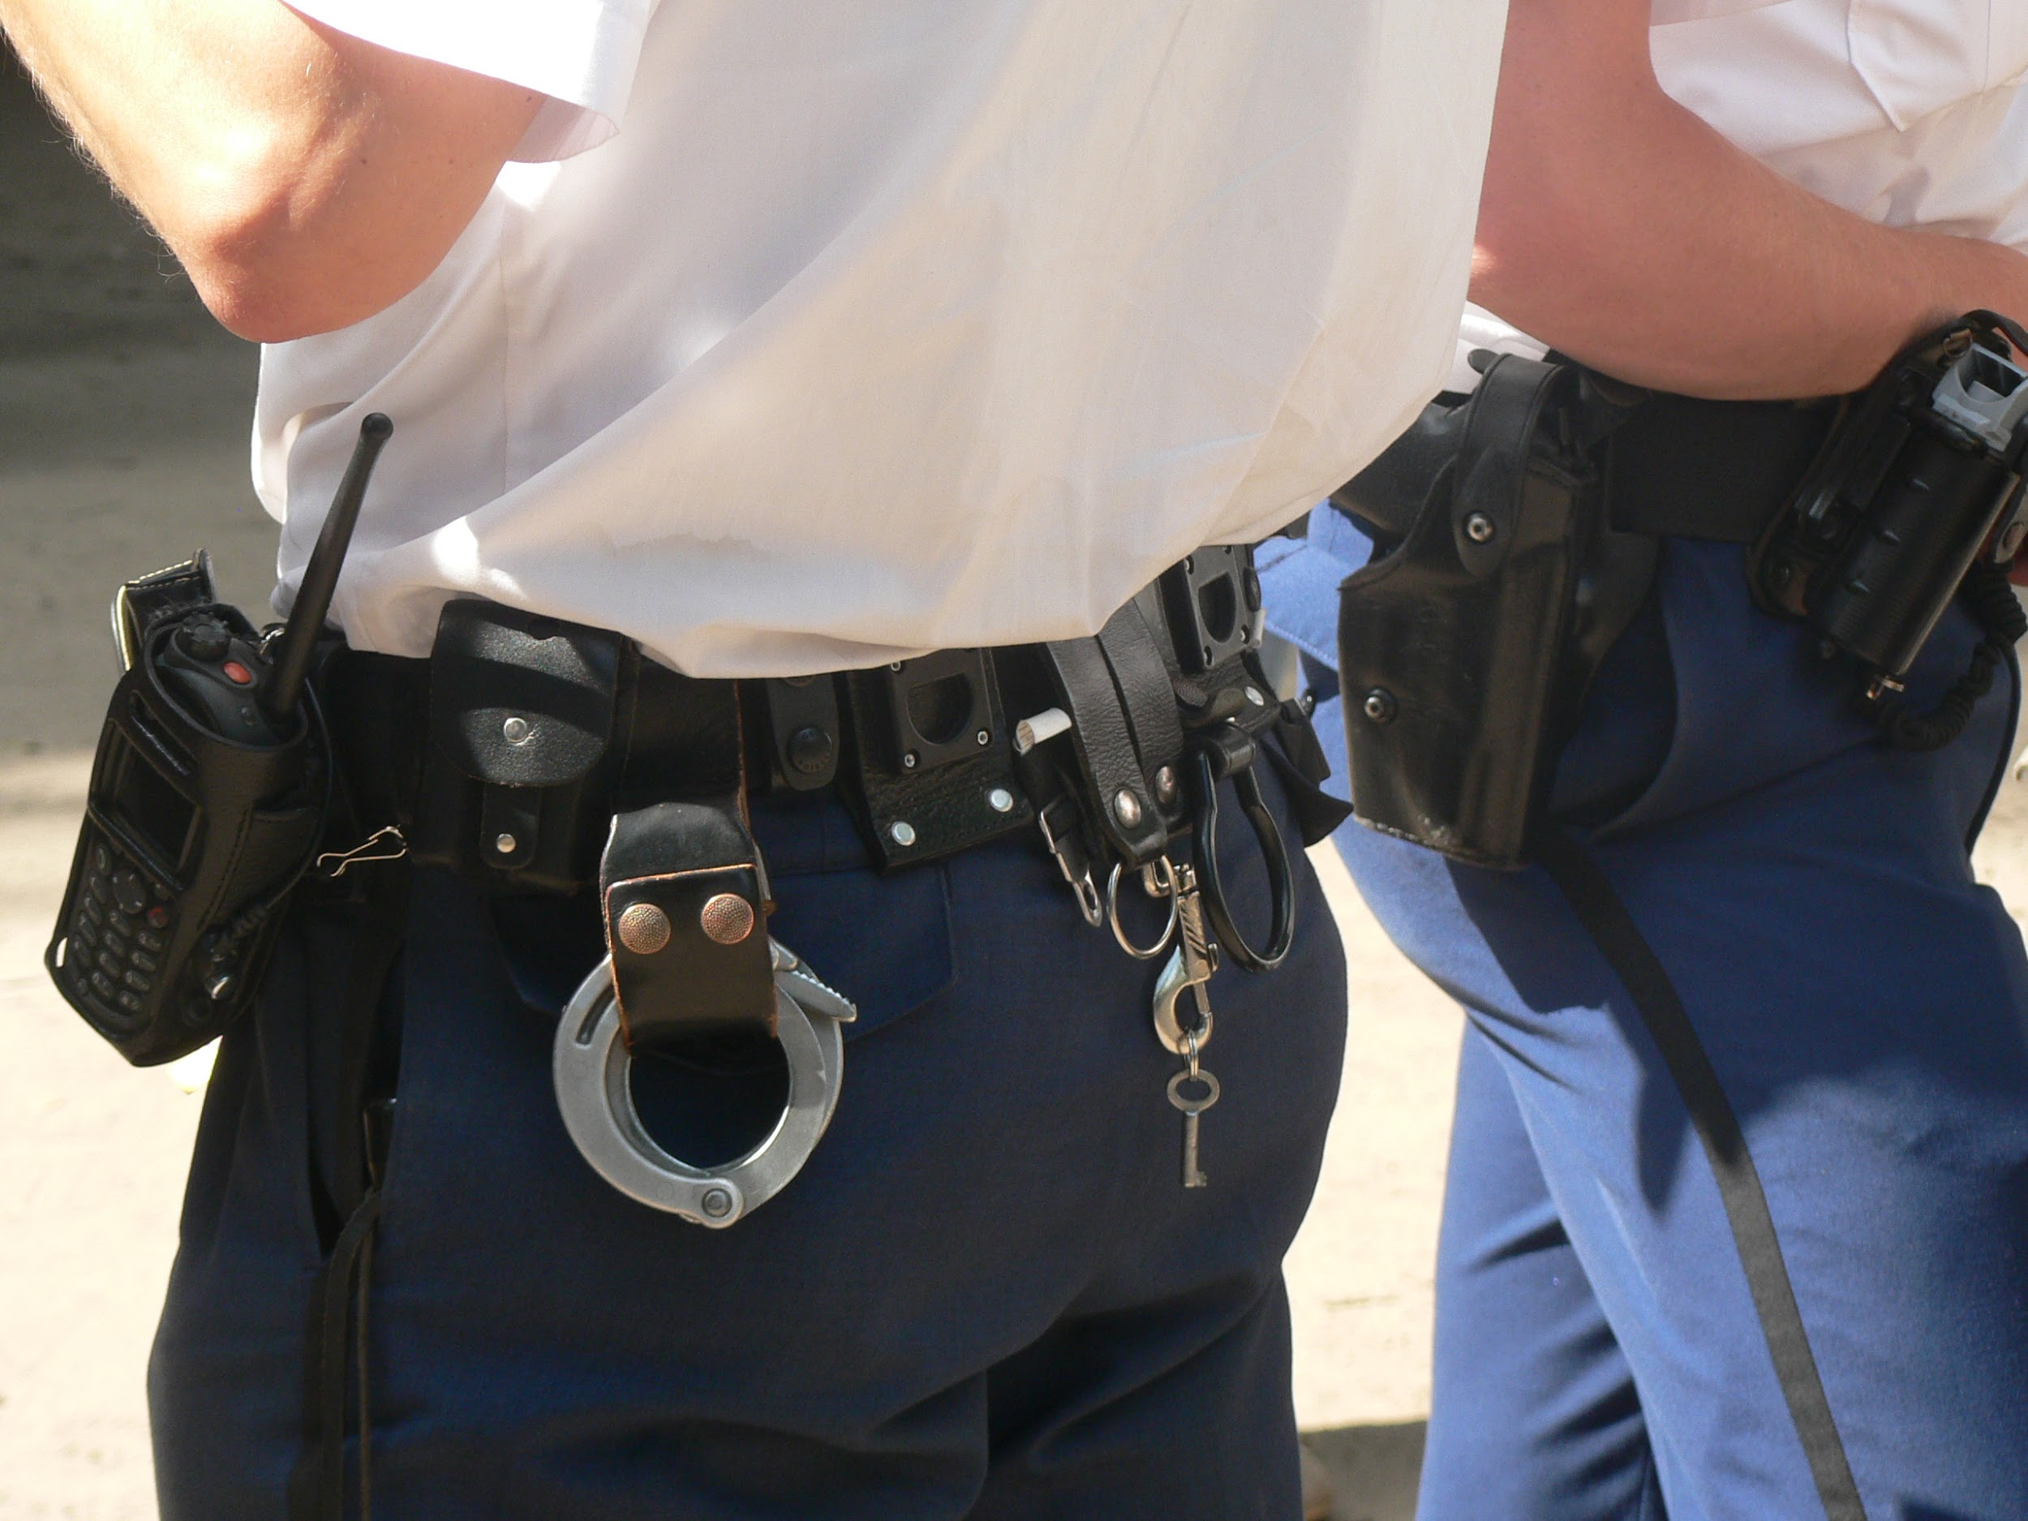
Notes:
It’s even possible to duplicate keys from a high resolution photo.
Photo of a Dutch police officer, taken at Hacking At Random 2009.

Slide 7
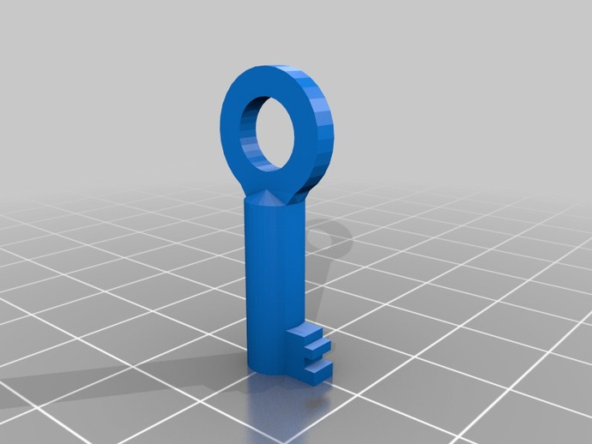
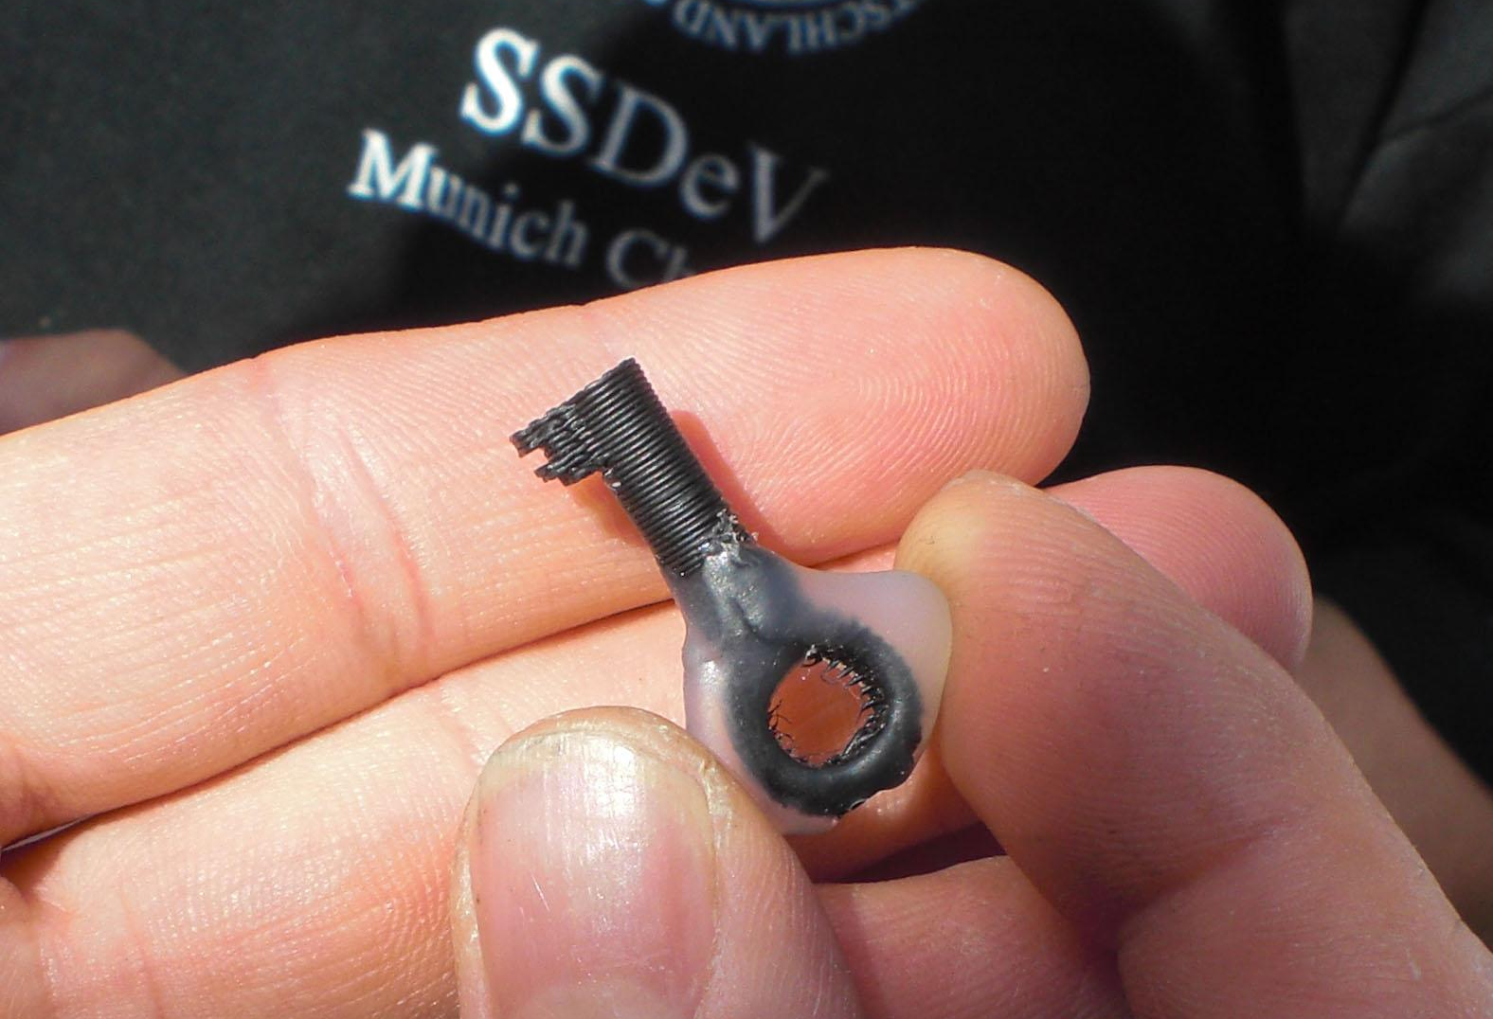
3D model
3D printed key
Notes:
Create a 3D model from a high resolution photo and 3D print it.
The 3D model can be downloaded from Thingiverse.com

Slide 8
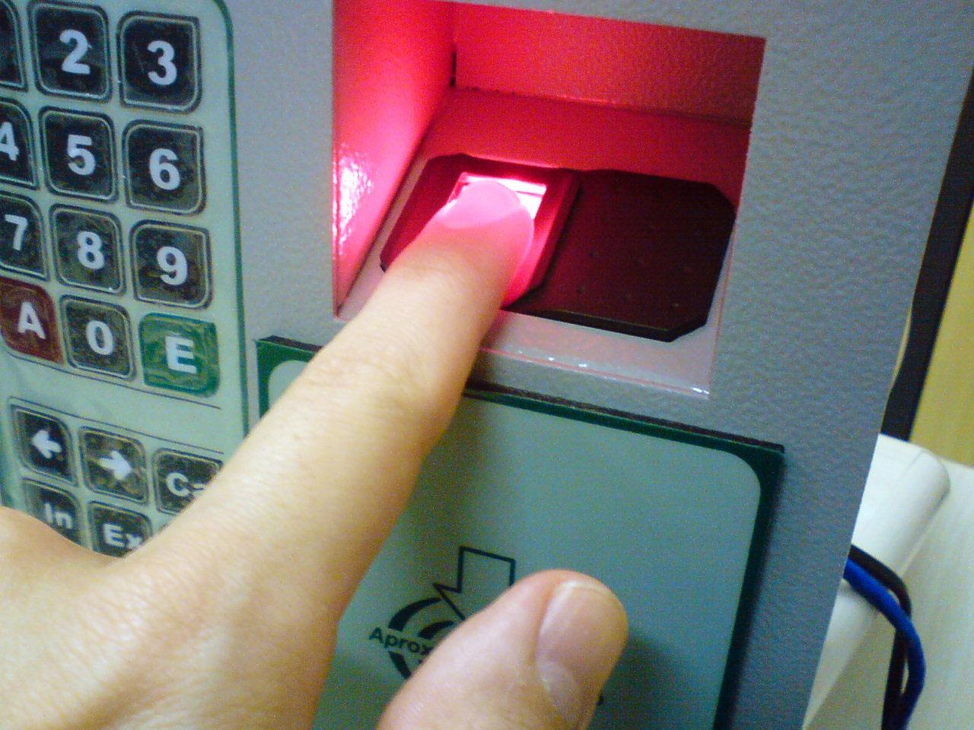
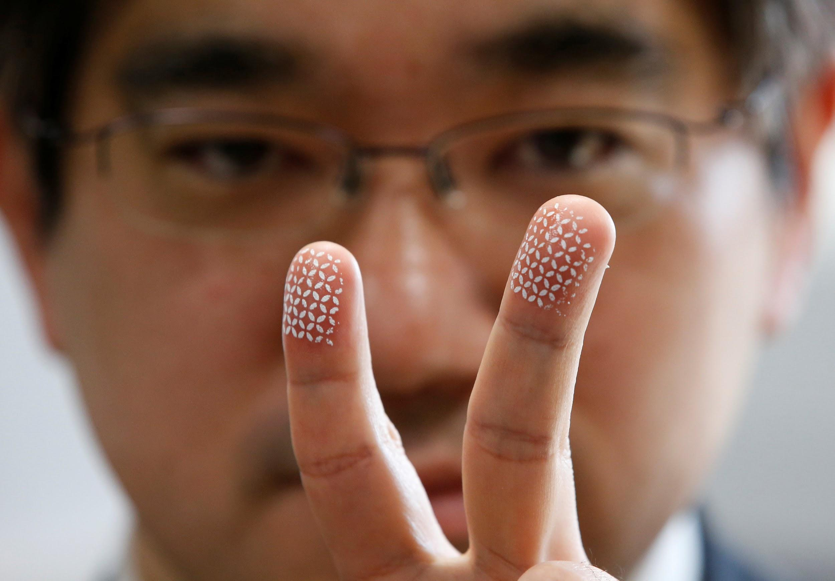
Disadvantages of biometric locks
Notes:
Biometric locks are a bad idea because everything we touch, we leave our fingerprints. When somebody takes a high resolution photo, your fingerprints or irises are compromised. When a fingerprint is compromised, we can’t change our fingerprint like we can change a password, code or implant.

Slide 9
Overview of non-medical implants:
Bioproof neodymium magnets in fingertips or tragus
Circadia
Eyeborg (wireless video camera in prosthetic eye)
Eyeborg (antenna to hear color frequencies)
Firefly (night light)
North Sense (compass)
NorthStar (LEDs)
Seismic Sense
RFID tags

Slide 10
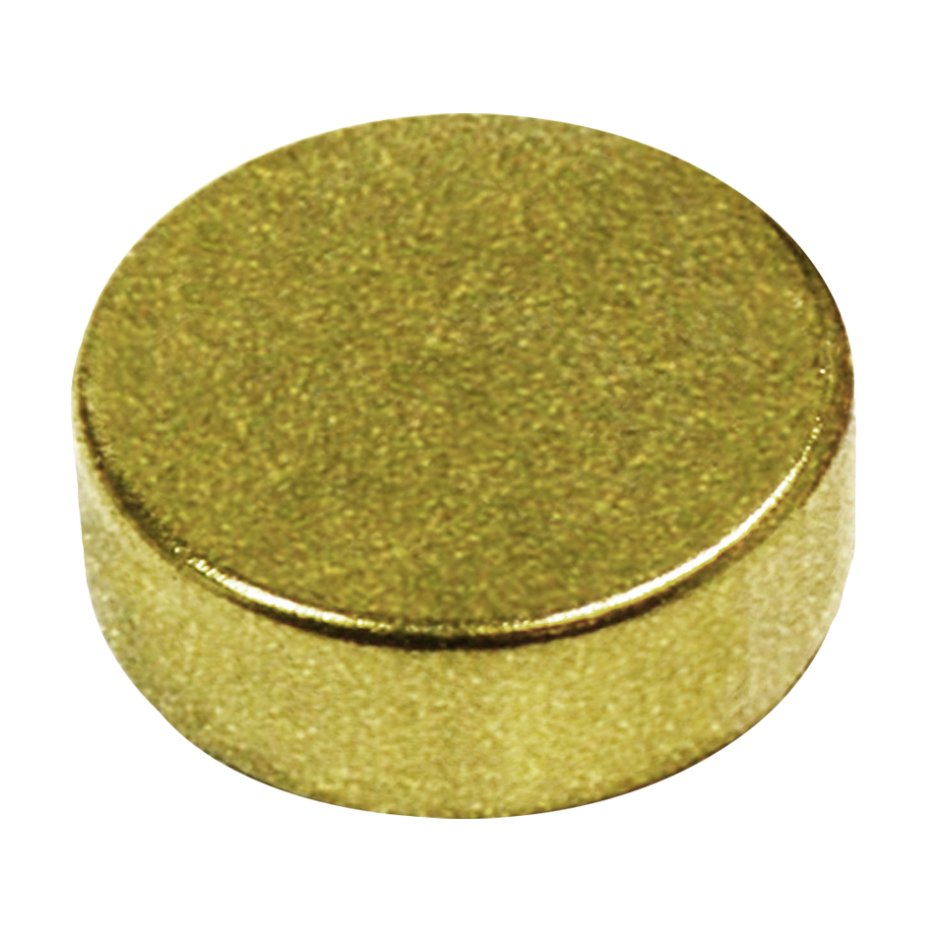
Magnet implants:
Fingertips are very sensitive because there are many nerve endings.
My magnet implants are 3 mm diameter, 1 mm high. Titanium Nitride coating to prevent rejection.

Slide 11
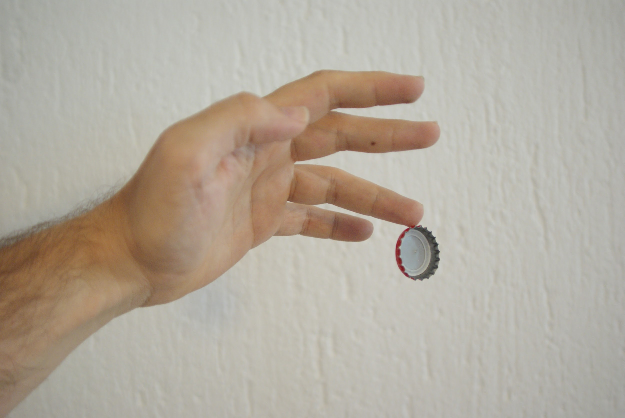
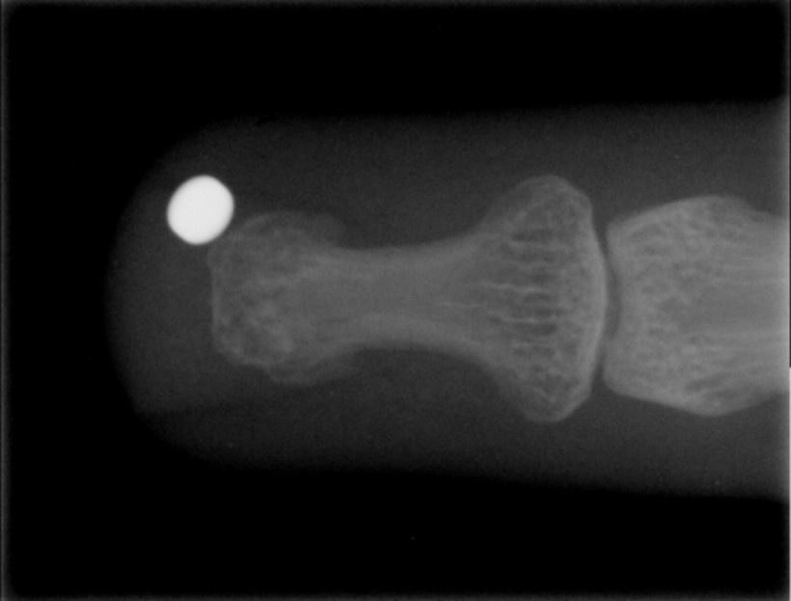
Magnet implants: lift objects
Picking up objects while working or for magic/party tricks:
Bottlecaps, coins, nails, paperclips, safety pins and screws.

Slide 12
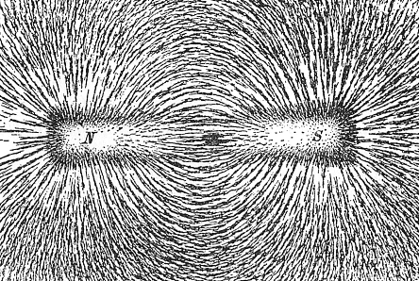
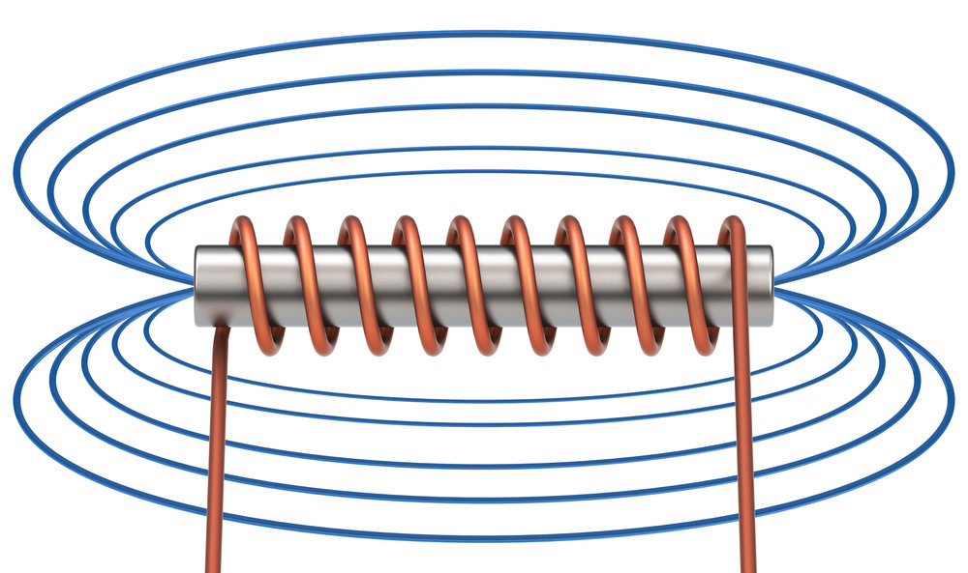
Magnet implants: Enhance senses
Fields are invisible, but they exist. This is how I can detect them.
Detect magnetic fields from short distances, magnet moves fingertip skin.
Magnet oscillates when near electromagnetic field, feels like tingling.

Slide 13
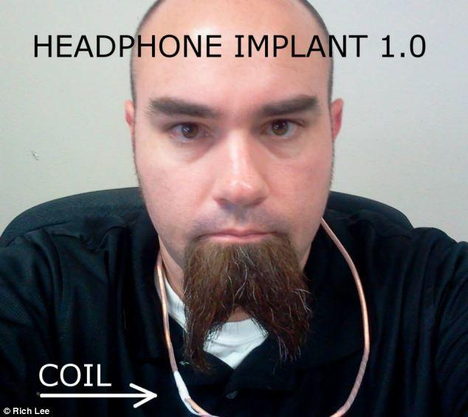
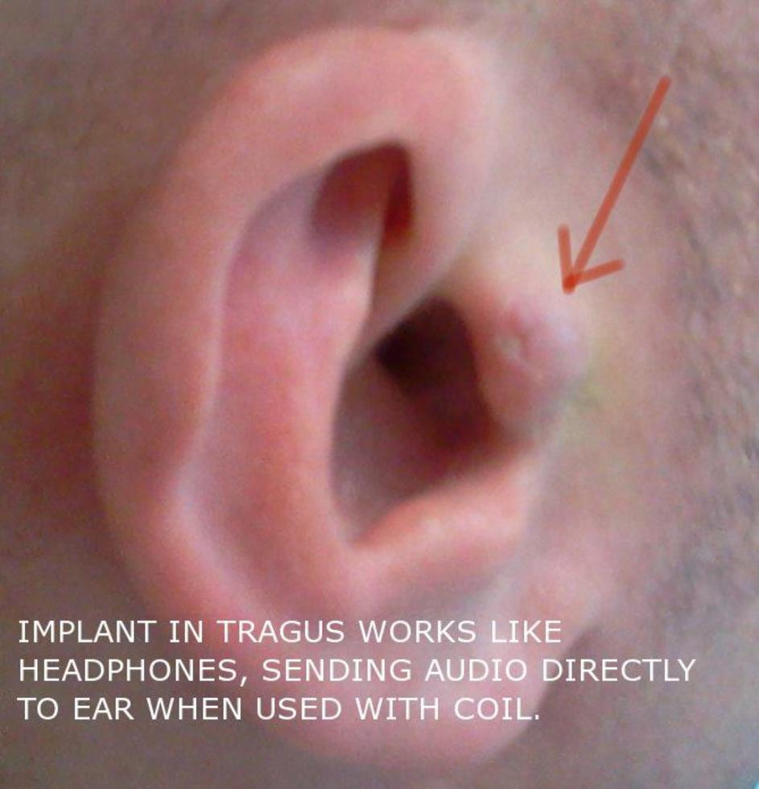
Magnet implants: invisible headphones
subdermal headphones
When implanted in the tragus and in combination with an amplifier and copper coil worn around the neck, the magnet can function as subdermal speaker.

Slide 14
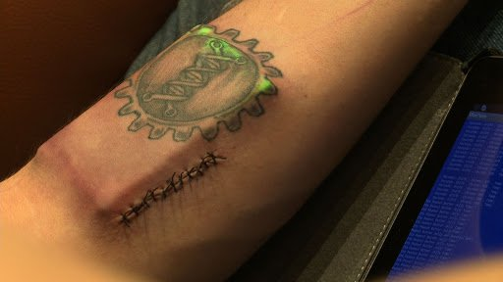
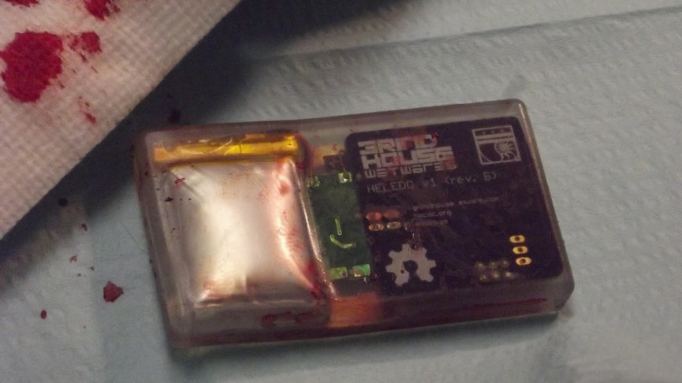
Circadia:
Made by Grindhouse Wetware
Measures body data, transmits data via Bluetooth.
Charging via induction, but implant was removed after battery problem.

Slide 15
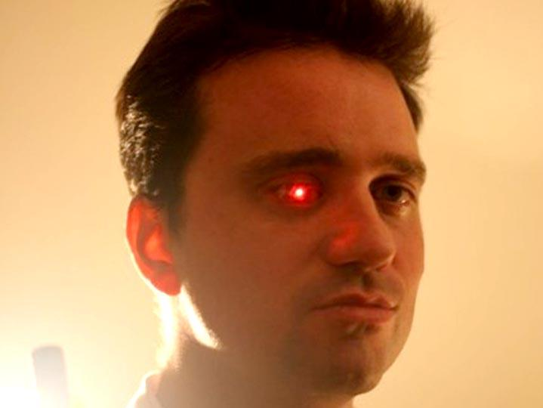
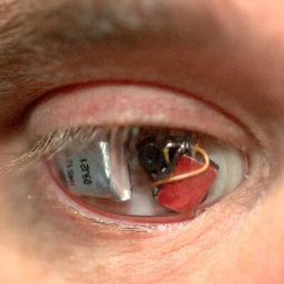
Eyeborg: wireless video camera in prosthetic eye
Prosthetic eye with wireless video camera.
Worn by director / filmmaker Rob Spence.

Slide 16
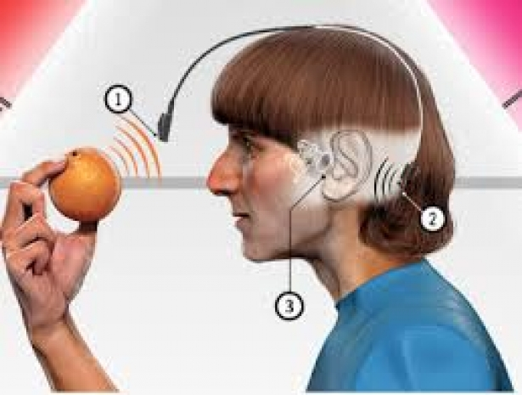
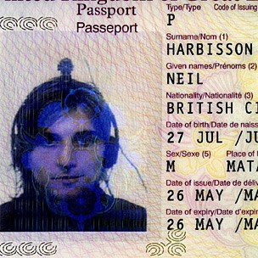
Eyeborg: transform colors to audio frequencies
Neil Harbisson is color blind, but his implant changes color to tone frequency.
Government approved his passport photo with visible implant.

Slide 17
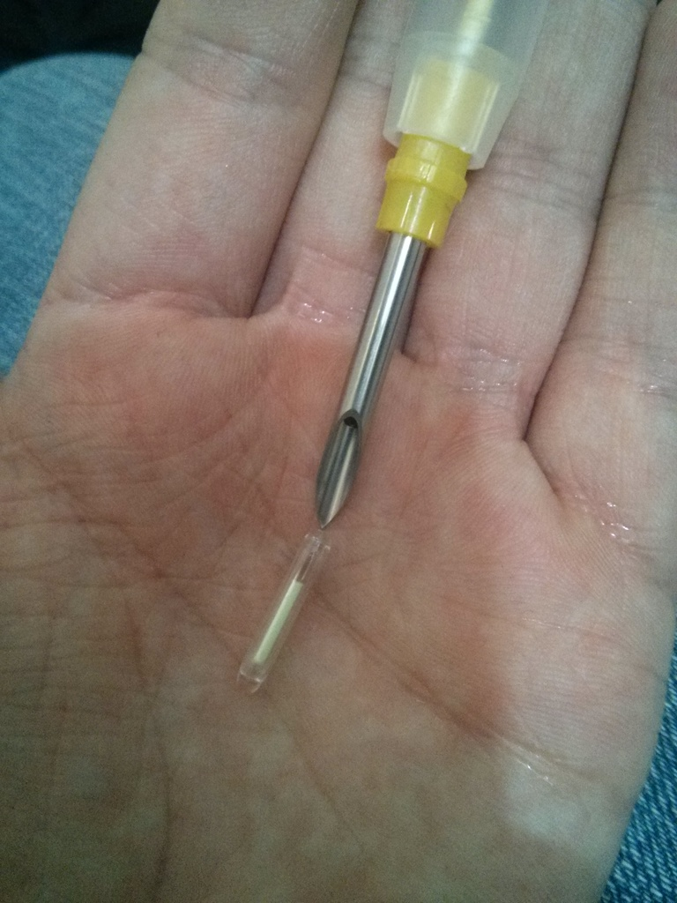
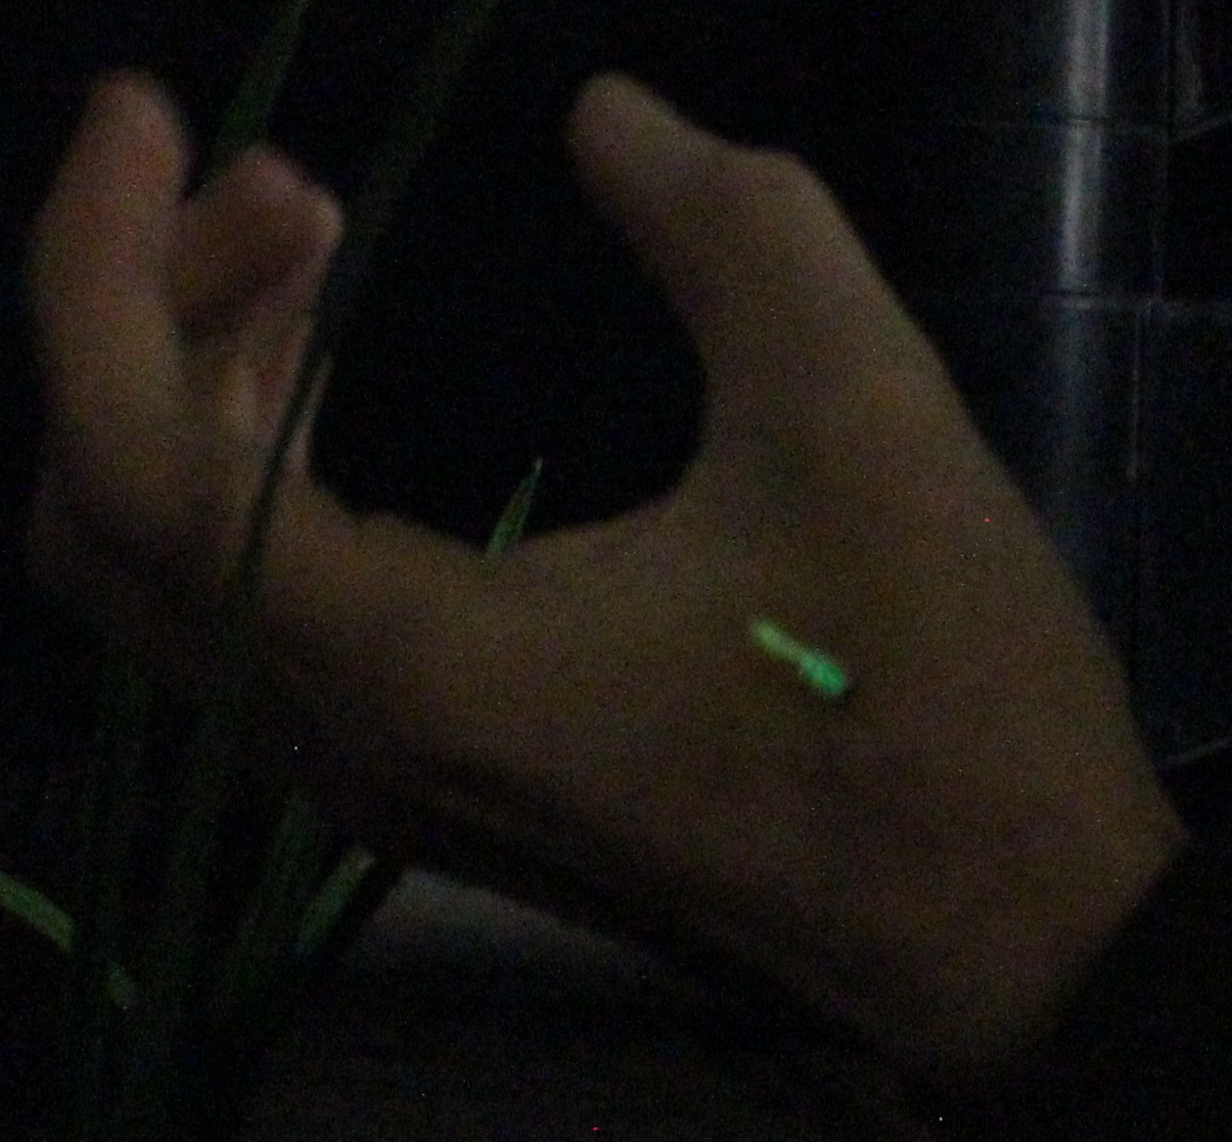
Firefly: tritium lighting implants
Created by cyberise.me, this tritium implant glows in the dark.
Implant emits a small amount of ionizing radiation.
Radiation reduced by special coating of lead oxide glass.

Slide 18
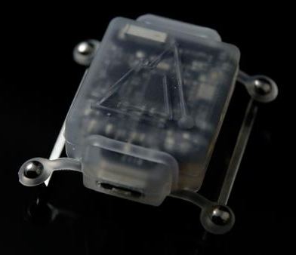
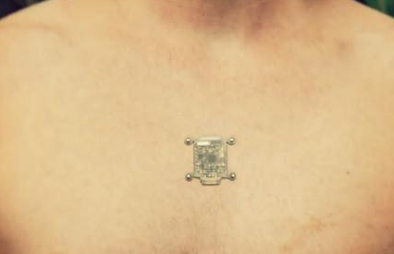
North Sense: external compass
Created by Cyborg Nest.
Compass vibrates when facing north.
Not an implant, but attaches to piercings.

Slide 19
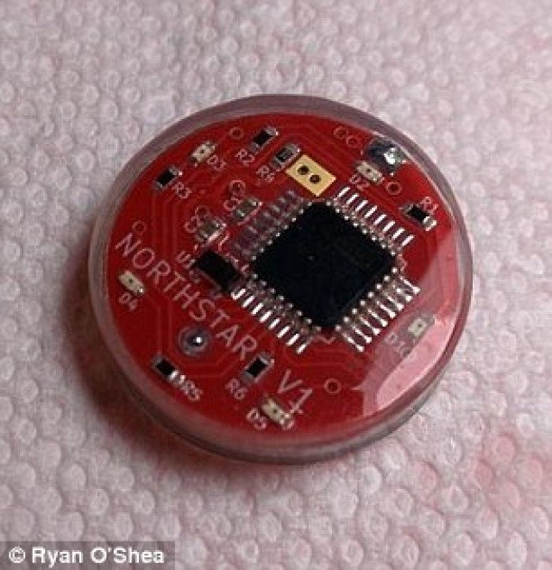
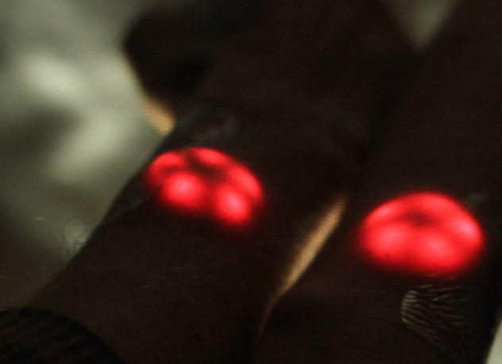
NorthStar V1: 5 red SMD LEDs
Made by Grindhouse Wetware. LEDs are activated by magnet.
Backlight tattoos, mimick bio luminescence.
Next version has gesture recognition.

Slide 20
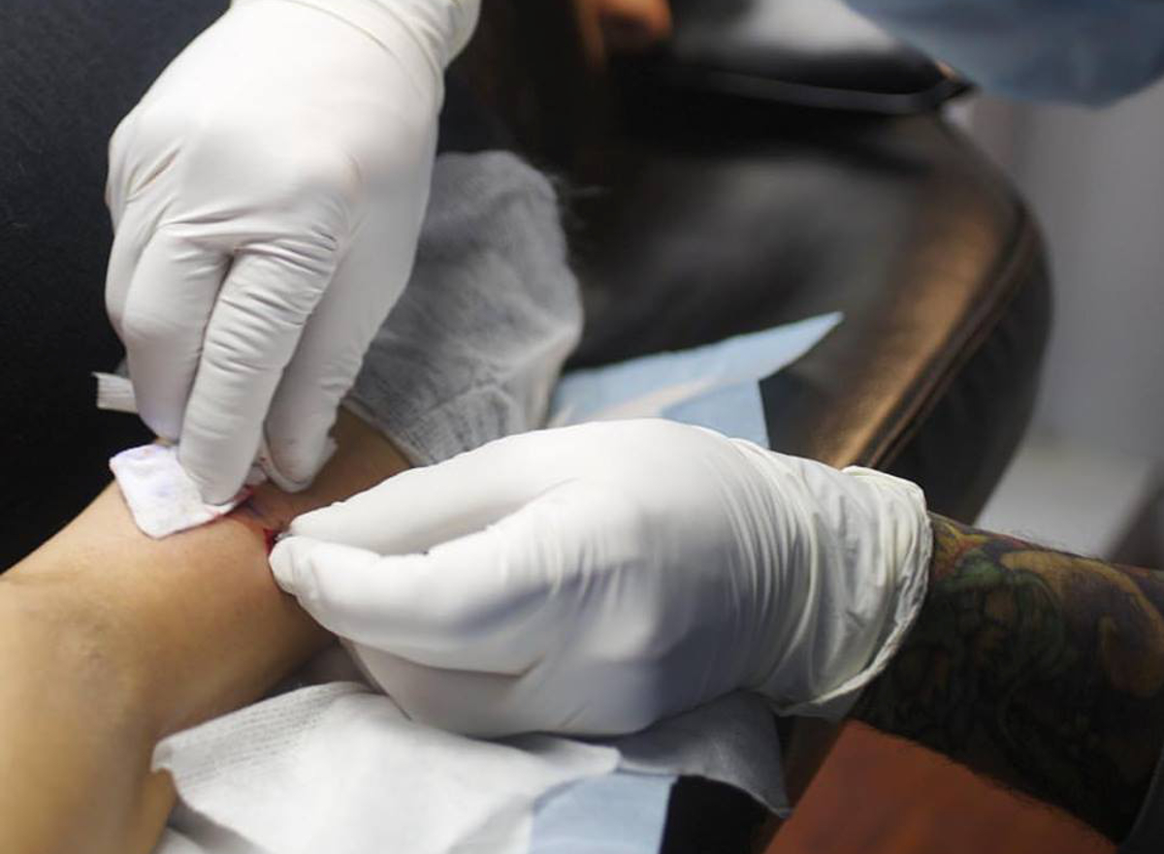
Seismic Sense
Implant in elbow allows wearer to feel earthquakes through vibrations.
Wirelessly connects to online seismographs, any earthquake in the
world of 1 Richter and above.
Worn by Moon Ribas, who uses it in her choreography.

Slide 21
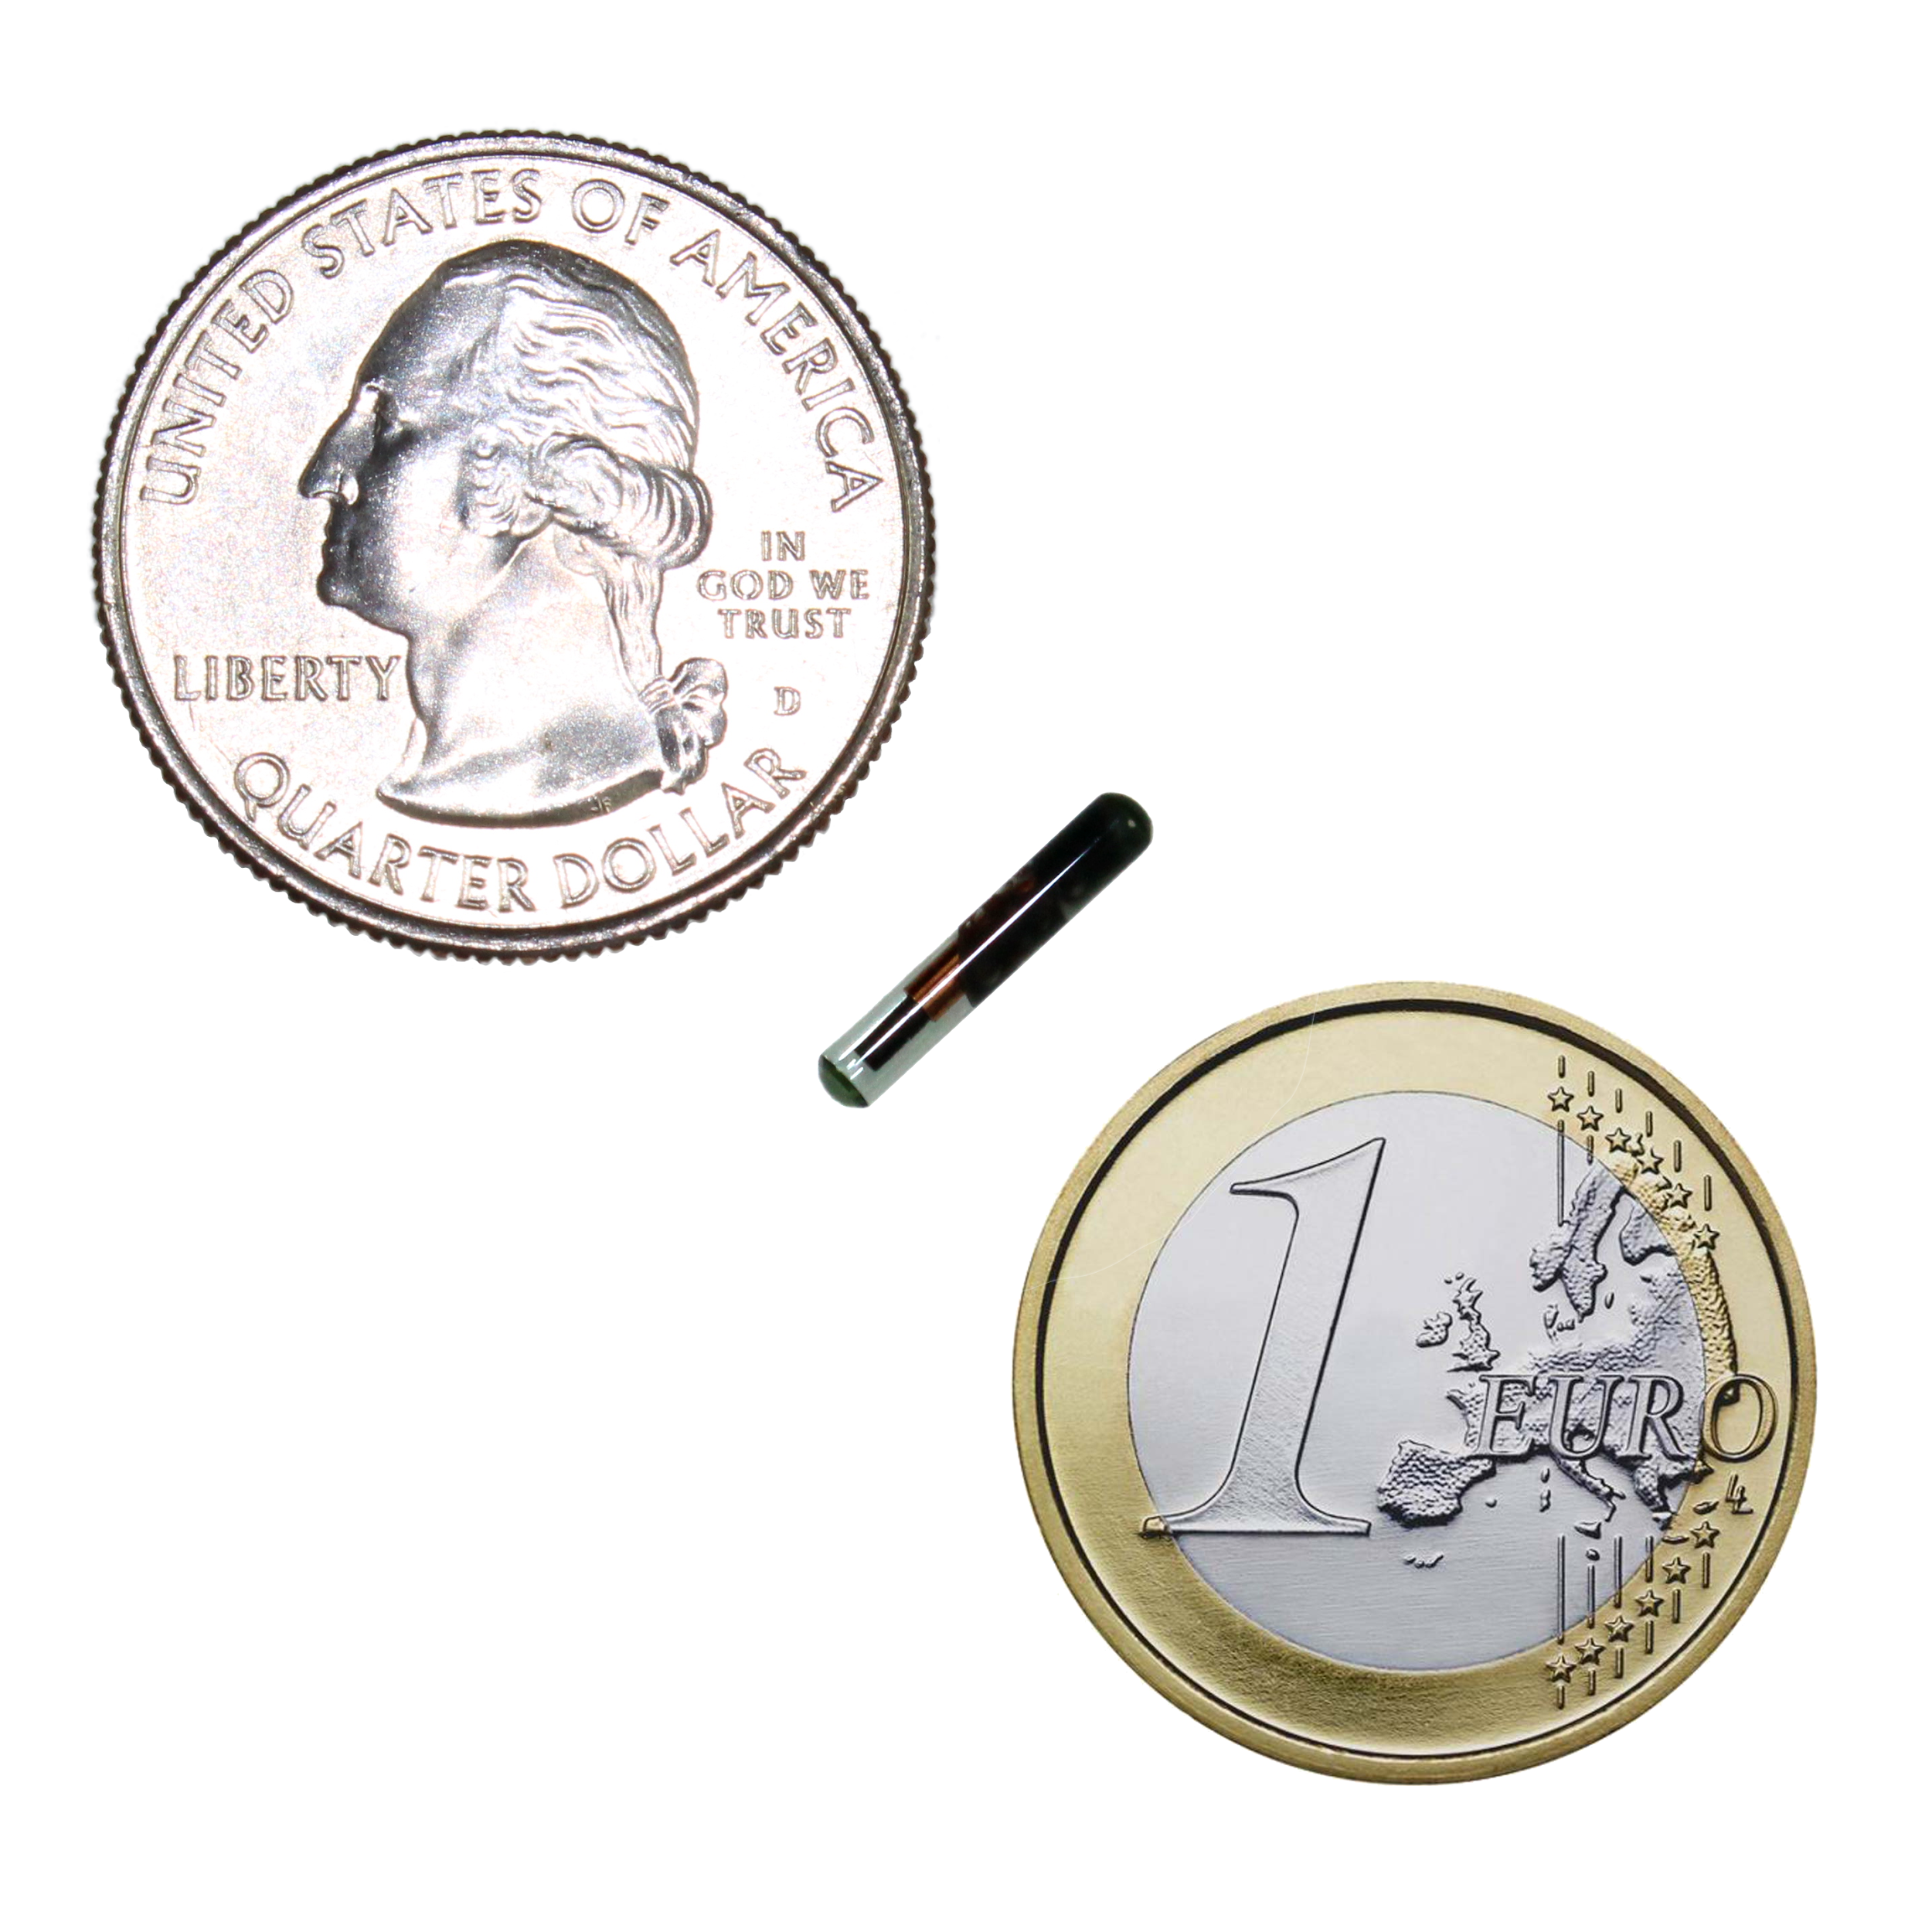
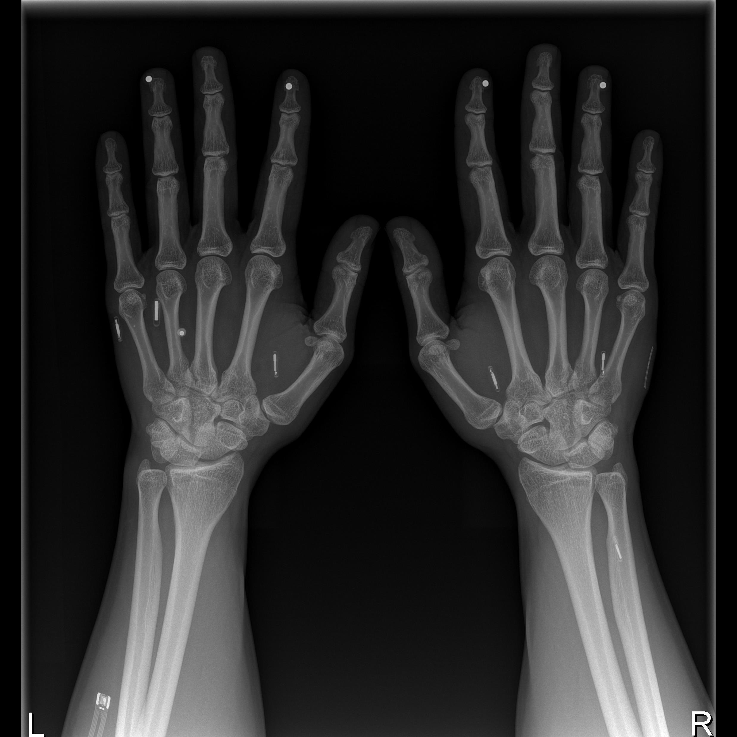
RFID tag implants: x-series
Made by Dangerous Things.
Biologically safe 2x12mm cylindrical bioglass tube
Pre-tested and pre-loaded in sterile injection assembly
No “anti-migration” coating means easy removal/replacement

Slide 22
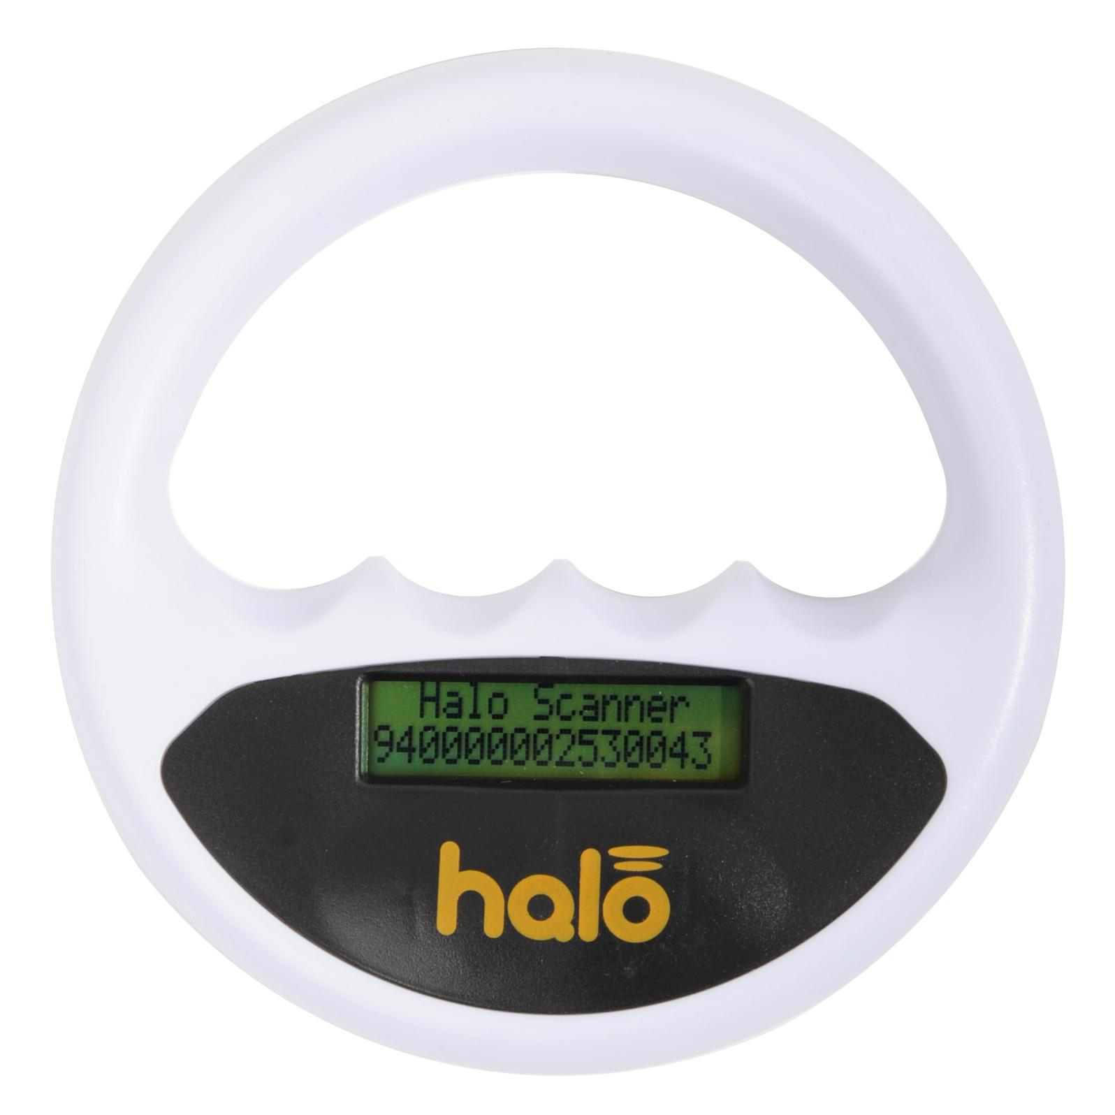
RFID tag implants: xBT
Technical specifications:
134 kHz FDX-B Bio-Thermo LifeChip
38 bit unique read-only ID number
Will read and report temperatures
between 23.5C and … TBD
BioBond “anti-migration” cap secures
the tag once inside the body
My purposes:
Read temperature of my lower arm.
I registered my xBT implant on an animal database with "pet owner" emergency contact details.

Slide 23
RFID tag implants: xEM
Technical specifications:
125kHz Low Frequency ISO11784/785 Atmel ATA5577 RFID chip.
Compatible with EM41xx, HID ProxCard II, and Indala systems.
Clone EM41xx IDs, HID ProxCard II, and Indala IDs to the xEM.
Pre-programmed in EM41xx mode with a 40 bit unique ID.
My purposes:
Unlock car doors: tag in EM41xx mode, RFID access controller connected to central door locking system.
Hobby projects with RFID reader, access controller.
2nd implant: Unlock doors at another office building, gain access to parking lot
(HID, Wiegand protocol).

Slide 24
RFID tag implants: xIC
Technical specifications:
13.56MHz High Frequency ISO/IEC 15693 I-CODE SLI RFID chipset.
8 byte UID and 112 bytes of user read/write memory
10 year data retention. Rated for 100k writes per memory block.

Slide 25
RFID tag implants: xM1+
Technical specifications:
13.56MHz ISO14443A compliant Mifare Classic S50 1k emulator.
Emulates MF1ICS50 1k chip with "Chinese Magic Backdoor" command support.
7 byte UID and all of sector 0 is writable using CMB commands.
10 year data retention. Rated for 100k writes per memory block.
Encased in 3x13 mm bioglass with non-toxic epoxy.
My purpose:
Unlock door at building where my hackerspace is.

Slide 26
RFID tag implants: xNT
Technical specifications:
13.56MHz ISO14443A & NFC Type 2 compliant NTAG216 RFID chipset.
7 byte UID and 880 bytes of user read/write memory.
10 year data retention. Rated for 100k writes per memory block.
My purposes:
Unlock smartphone.
Share contact details (vCard) via NFC.
Share GPS coordinates, medical data, text, lyrics, poem, URL.
Control electronics with Arduino & NFC module.
Control slides of this presentation.

Slide 27
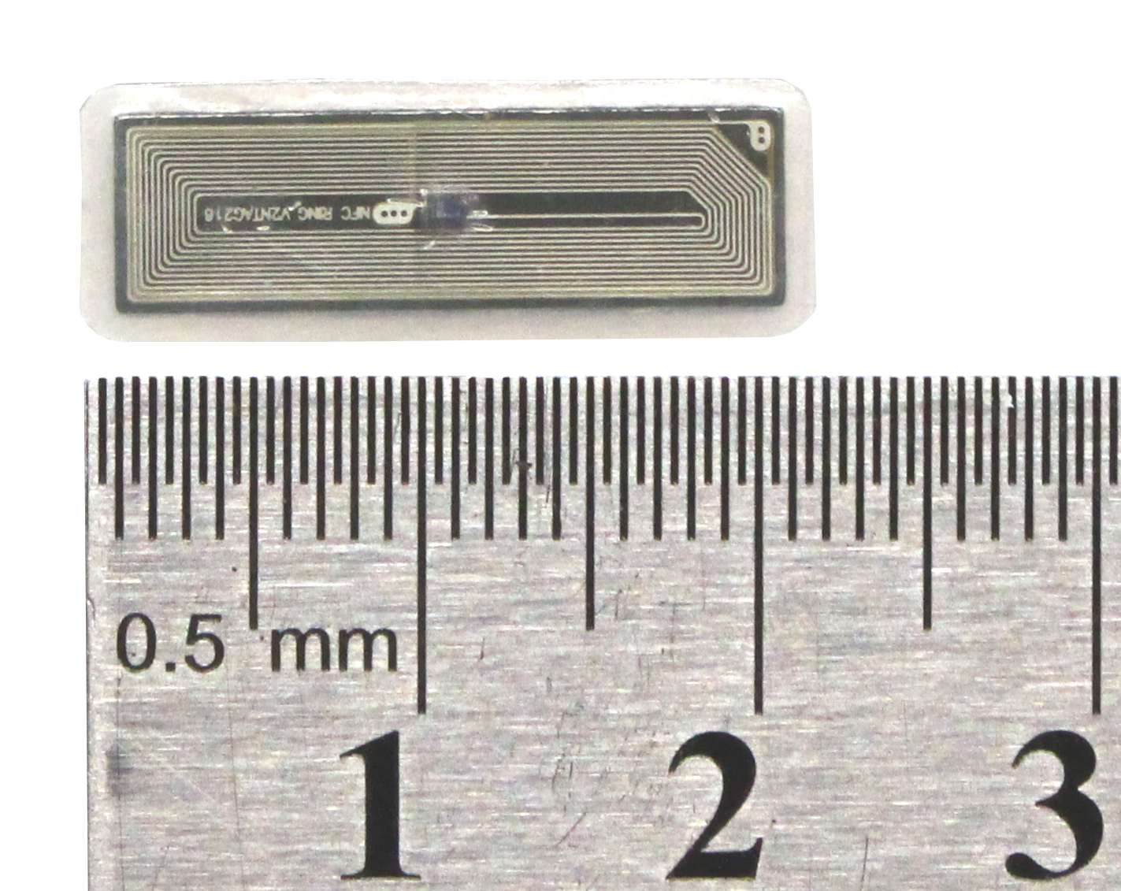
RFID tag implants: flexNT
Same tag as xNT, but different shape and size.
8x22x0.4mm flexible biopolymer package
My purposes:
Unlock doors at home, office.
Share contact details (vCard) via NFC.
Share GPS coordinates, medical data, text, lyrics, poem, URL.
Control electronics with Arduino & NFC module.

Slide 28
RFID tag implants: flexDF
BETA product
Technical specifications:
13.56MHz ISO14443A & NFC Type 4
Mifare DESFire EV1 8k chip
10x22x0.5mm flexible biopolymer package

Slide 29
RFID tag implants: VivoKey
Technical specifications:
13.56MHz ISO14443A & NFC Type 4
NXP SmartMX2 chip
Java card applets
10x22x0.5mm flexible biopolymer package
My purposes:
Generate OTP codes for 2-factor authentication for more secure log ins.
PGP data & e-mail encryption, decryption, signing.
Potential future purposes:
Financial transactions at any contactless payment terminal?

Slide 30
RFID tag implant safety tests
Vacuum test to 0.42mBar.
It would survive the vacuum of low earth orbit or outer space.
Liquid nitrogen tested
Electromagnetic pulse (EMP) machine tested.
Growth / sterilization tested.
Cooked in an oven at 375F for 30 minutes.
Crush tested up to 500 Newton (machine maximum).
MRI tested up to 7 Tesla.

Slide 31
Implant methods
Methods of inserting implants in the body.
RFID glass tags: RFID tag pre-loaded in sterile injection assembly.
Other types of implants: scalpel, dermal separator, stitches.

Slide 32
Implant coatings
Materials used by professionals to make implants bioproof:
Bioschott glass
Parylene-C
Titanium Nitride (TiN)
Materials used by DIY biohackers:
Hot glue
Sugru

Slide 33
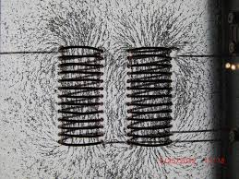
Advantages & hardware limitations:
Limited data storage capacity.
See technical specifications of
individual implants.
Don't worry about forgetting or losing keys.
Passive devices, no battery required.
RFID tag implants only are active when near an RFID reader.
Read range depends on strength, shape and orientation of coils, magnetic coupling between RFID reader and tag.
Short reading distance; no long distance data collection.
Sometimes you need to find the “sweetspot” in smartphones.

Slide 34
Common questions and concerns
Airport security
Laws
Payments
Privacy concerns
Notes:
Metal detector gate, handheld metal detector, full body scanner.
No payments at any terminal yet. Either Bitcoin payments or tokens at cantinas / fitness centers with their own system.
I decide what data I write on my implants.

Slide 35
Thank you!
Contact information:
E-Mail: v@icario.us
Twitter: Vicarious1984

