Slide 1

The RTOS
Exploit Mitigation Blues
Jos Wetzels
HARDWEAR.IO
Notes:
Hello and welcome to my talk ‘The RTOS exploit mitigation blues’

Slide 2




Jos Wetzels
Independent
Security Researcher
ICS
IoT
Automotive
Medical
Access Controls
Networking & Firewalls
(Former)
Security Researcher
Critical Infrastructure
Embedded BinSec
HIDS / NIDS
@s4mvartaka
www.midnightbluelabs.com
samvartaka.github.io
Notes:
First a little bit about my self. My name is Jos Wetzels and I’m currently an independent security researcher with midnight blue where I focus mainly on embedded systems security. I previously worked as a security researcher with the university of twente where I focused mainly on critical infrastructure protection, embedded binary security and host- and network-based intrusion detection systems.

Slide 3

ROADMAP
Background
Quantitative Analysis
RTOS Mitigation Examples
Embedded Mitigation Criteria
μArmor
Notes:
So I’m gonna start this talk off with a little bit of background and then move on to a quantitative analysis of the state of embedded exploit mitigations.
Then I’ll discuss some real world RTOS exploit mitigation examples and outline what I think are decent criteria for embedded mitigations. I’ll finish this talk by present uArmor, an exploit mitigation baseline I designed for deeply embedded systems.

Slide 4
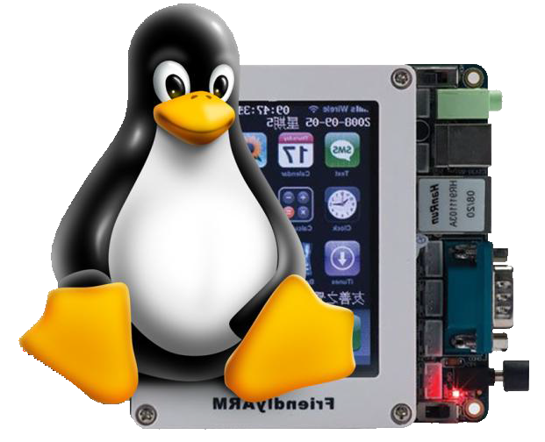



What this talk is not about
Notes:
So what is this talk not about? It’s not about embedded operating systems derived from ones encountered in the general purpose world such as embedded Linux, NetBSD or Windows IoT

Slide 5



What this talk is also not about
Notes:
It’s also not about high-end embedded operating systems with real-time properties such as real time linux, xenomai or QNX.

Slide 6
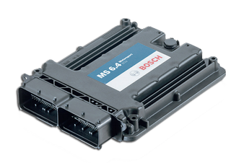

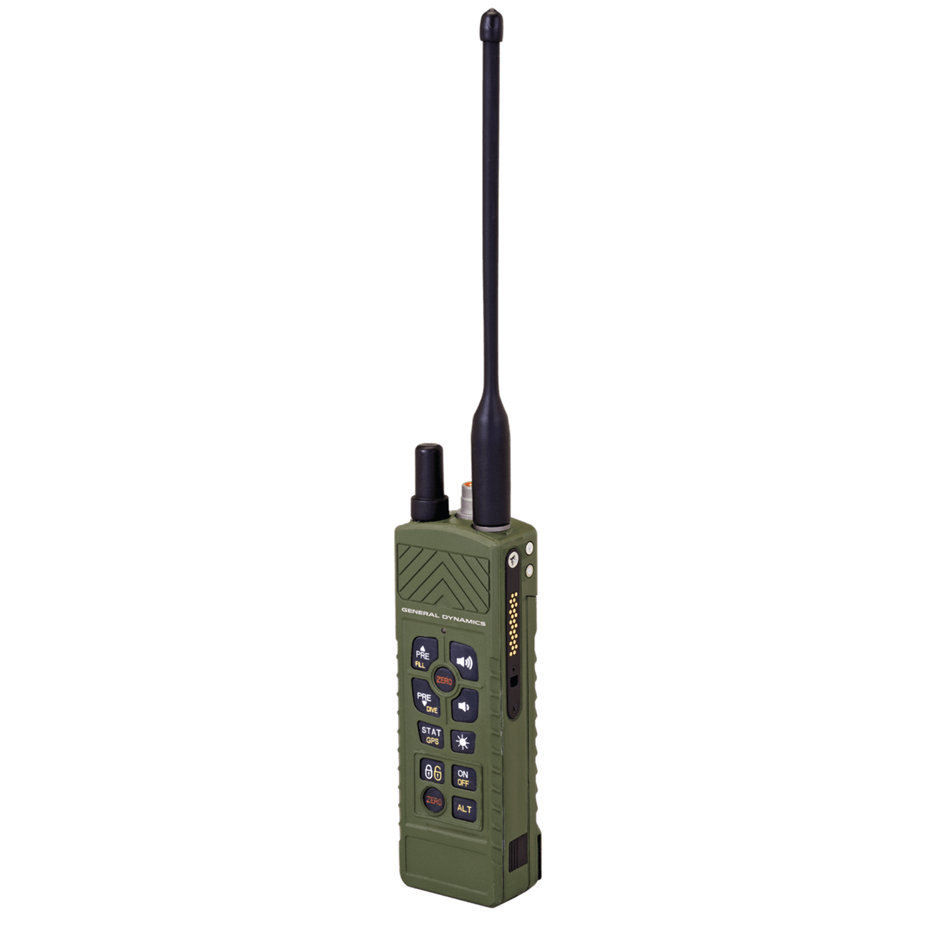

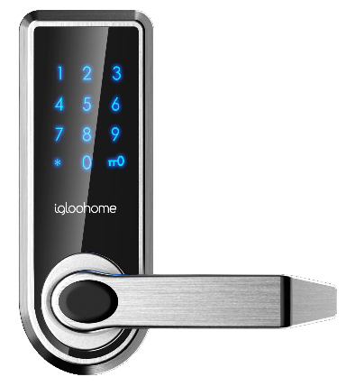

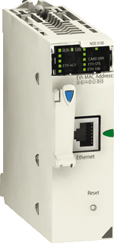




What this talk is about
Notes:
What this talk is about is small real-time operating systems running on heavily constrained deeply embedded systems such as radios, smartlocks, ECUs, PLCs and IoT devices.

Slide 7
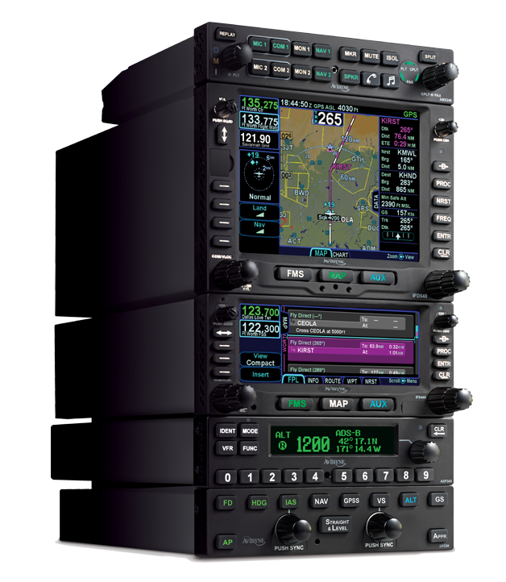
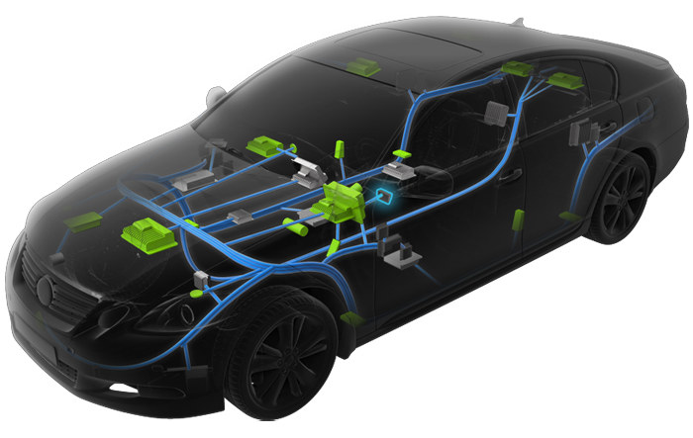
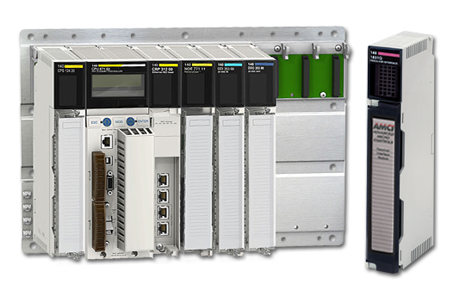
Real-Time Operating System (RTOS)
Guarantee Response within Time Constraints
Important in safety-critical sys.
Predictability & Determinism > Speed
Soft RT -> Usefulness of result degrades after deadline
Hard RT -> Missing deadline = system failure
Notes:
So, what is a real-time operating system? A real-time operating system is capable of guaranteeing a response within certain time constraints, something that’s very important in safety-critical systems such as automotive or avionics.
Here predictability and determinism are more important than speed. There’s varying degrees of ‘real timeness’, such as soft real time where the usefulness of results degrades after a deadline has been missed and hard real time where
missing a deadline is considered a system failure.

Slide 8
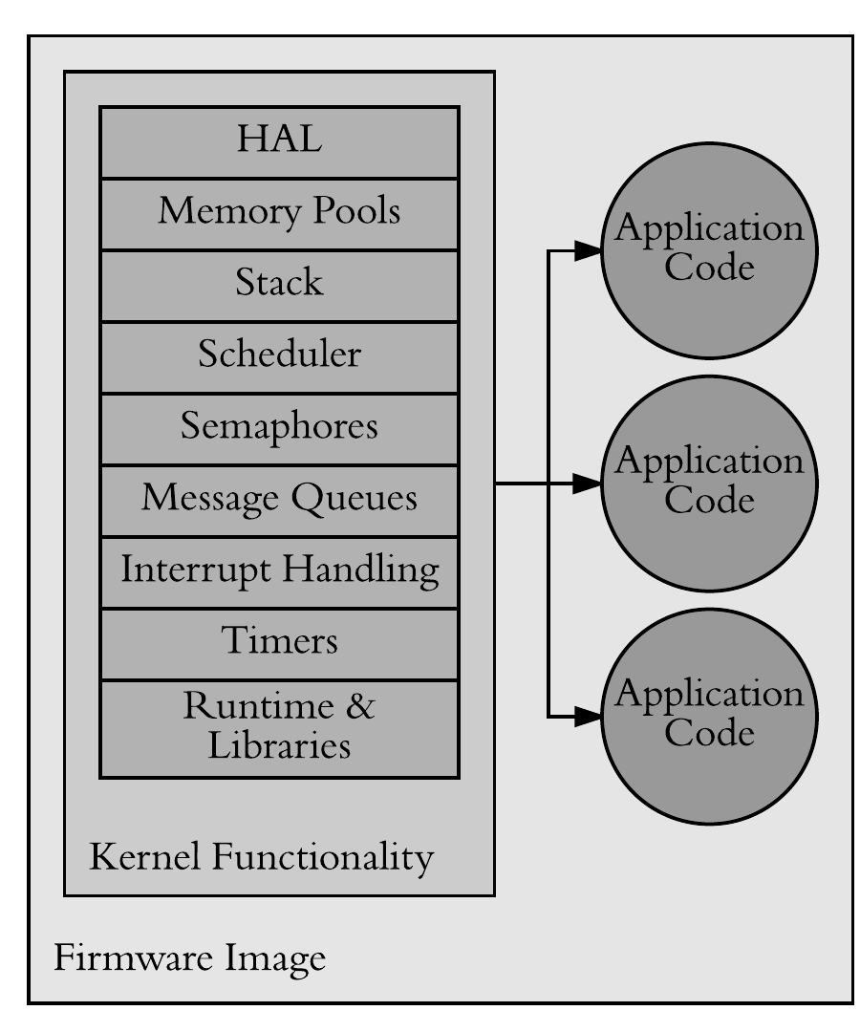
Library / Unikernel OS
OS as collection of libraries
Linked with application code into single address space image
No loader, Syscalls implemented as function calls
Saves context-switching
Notes:
Many real-time operating systems are implemented as so-called library or unikernel OSes. Where the operating system is implemented as a collection of libraries which are linked together with the application code into an image loaded into a single address space. Usually there’s no program loader and system calls are implemented as function calls which saves context-switching overhead.

Slide 9
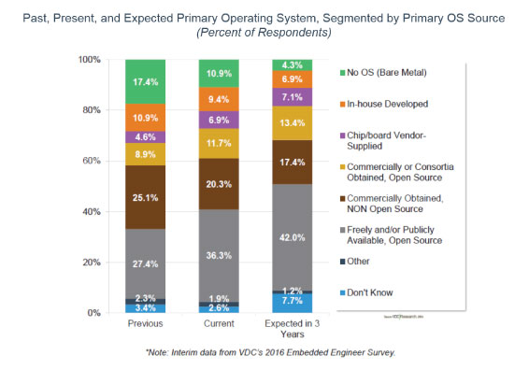
Rising Embedded RTOS Usage
Notes:
As you can see in the figure on the slide, in recent years there’s been a rise in the use of RTOSes in embedded systems compared to bare-metal systems.

Slide 10
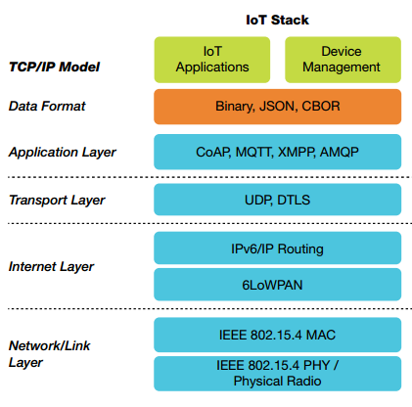
Increasing Connectivity
Protocol Stacks Everywhere
Talk to gateway, other nodes, smartphones, integration with cloud, etc.
Notes:
One cause for this rise is increasing connectivity: there are protocol stacks everywhere allowing devices to connect to gateways, other nodes, smartphones or have integration with the cloud.

Slide 11
Increasing Complexity
# Processors | Bare Metal | RTOS | Linux
1 | 33% | 18% | 13%
2-3 | 22% | 24% | 17%
4+ | 11% | 25% | 32%
More processors, memory, peripherals
Simple bare metal control loops & state machines not enough
Hence rise of RTOS
* 2017 Barr Group Embedded Systems Safety & Security Survey
Notes:
In addition to this increased connectivity, there is also a more general trend of increasing complexity. Devices have more processors, more memory and more peripherals.
And for these devices simple bare metal control loops & state machines are not enough, hence the rise of RTOS usage as you can see in the table on the left.

Slide 12

Embedded Binary Security
Notes:
So with the rise of RTOS usage, its security features are increasingly important. For the purpose of this talk we focus on embedded binary security in particular.

Slide 13
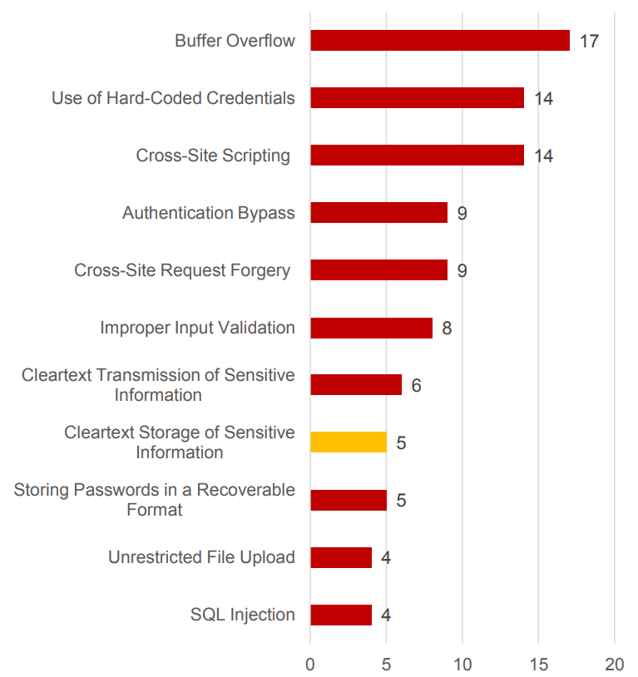
Memory Corruption is a Big Deal™ in Embedded
* 2016 ICS Vulnerabilities Statistics, Kaspersky
Notes:
Why? Because memory corruption issues are a big deal in embedded systems. For example, as the figure on the left shows, buffer overflows formed the biggest single category of vulnerabilities discovered in industrial control systems in a recent Kaspersky study.

Slide 14

Heightened Impact
Patching Issues
Fragmented Responsibility
Lack of Secure Update
Availability / Safety
Long Exposure Windows
‘Forever Days’
No Privilege Separation
Flat Memory Model
Exploits Scale Well
Single protocol driver bug can affect billions of devices
Notes:
And various factors contribute to heightening the impact of memory corruption vulnerabilities in embedded systems.
First of all, we’re all probably aware of the issues with patching. From confusion about whose responsible for drafting a patch to a lack of suitable mechanisms to apply them to issues around systems availability or safety re-certification.
This situation results in long exposure windows for affected devices, including what could be called ‘forever days’ where device lifetime exceeds vendor support and patches are never going to be applied.
Add to this the fact that there is usually little or no privilege separation due to flat memory models and the fact that a single bug in a single protocol driver can affect billions of devices and you can see how serious the situation is.

Slide 15

Unsafe Languages
Are Here To Stay
Ideally use safe languages
But unsafe continues to dominate
Despite old (Ada) and upcoming (Rust) embedded-suited langs
* 2017 Barr Group Embedded Systems Safety & Security Survey
Notes:
Since memory corruption issues arise from the use of unsafe languages ideally we’d solve this problem by using safe languages
But unfortunately, despite the availability of older or newer embedded-suited languages unsafe languages continue to dominate as the chart on the left shows, with the vast majority of embedded software being written in C or C++.

Slide 16
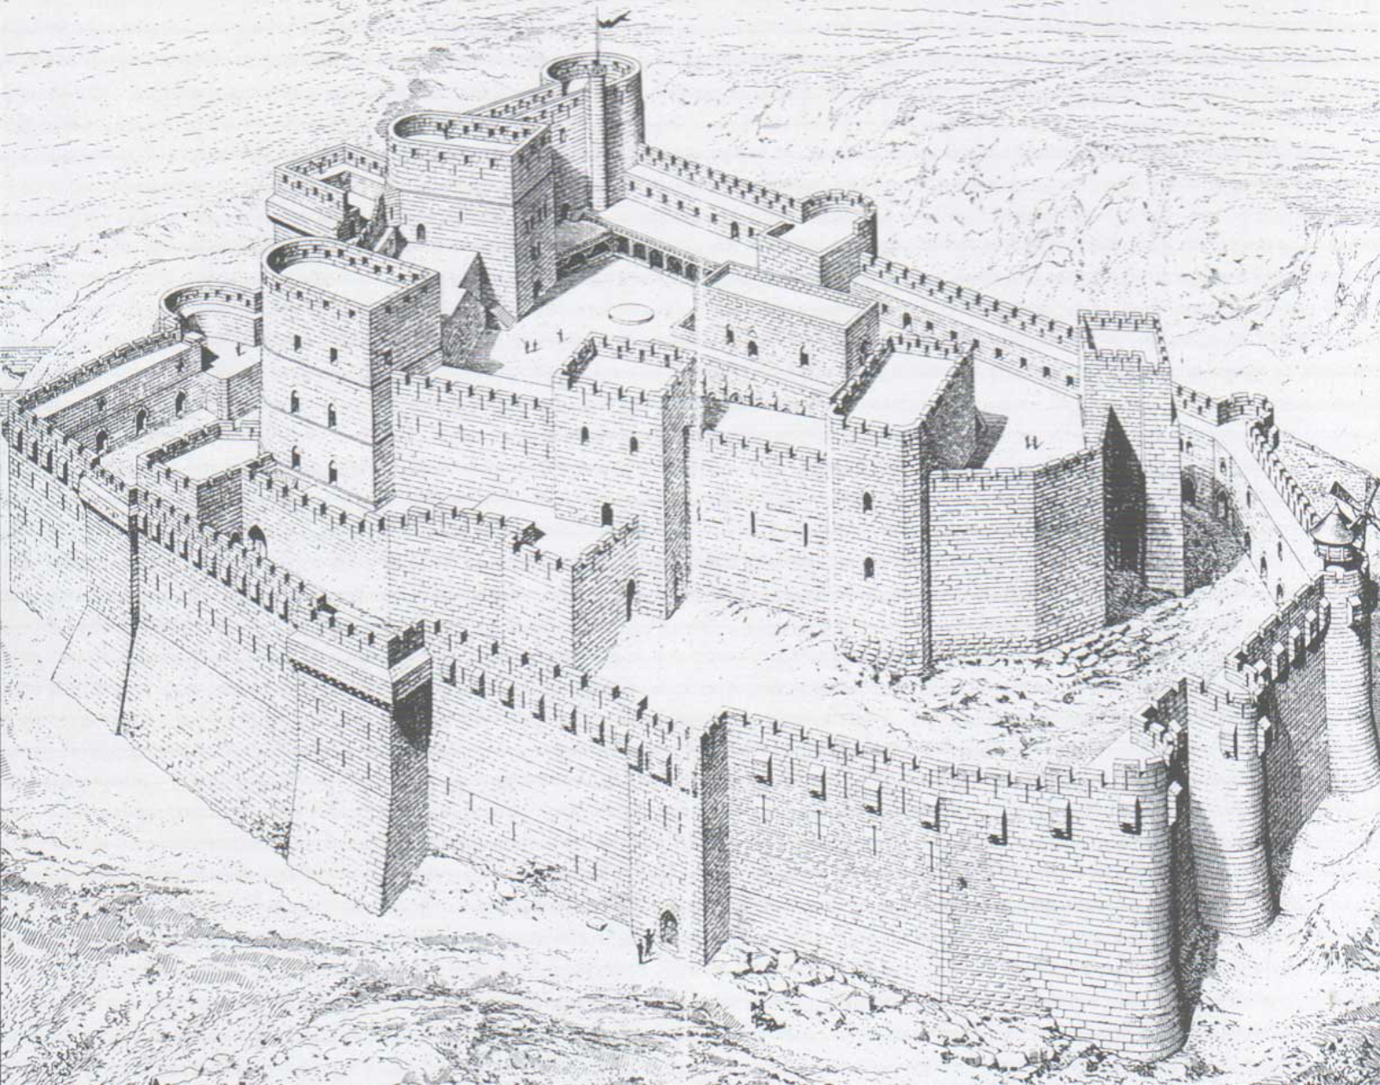
Exploit Mitigations
Notes:
So what now? Well, this is where exploit mitigations come in as sort of ‘stop-gap solution’ to increasing the complexity and reduce the impact of memory corruption vulns

Slide 17
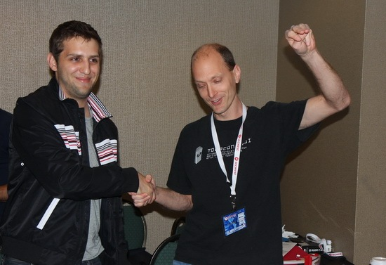
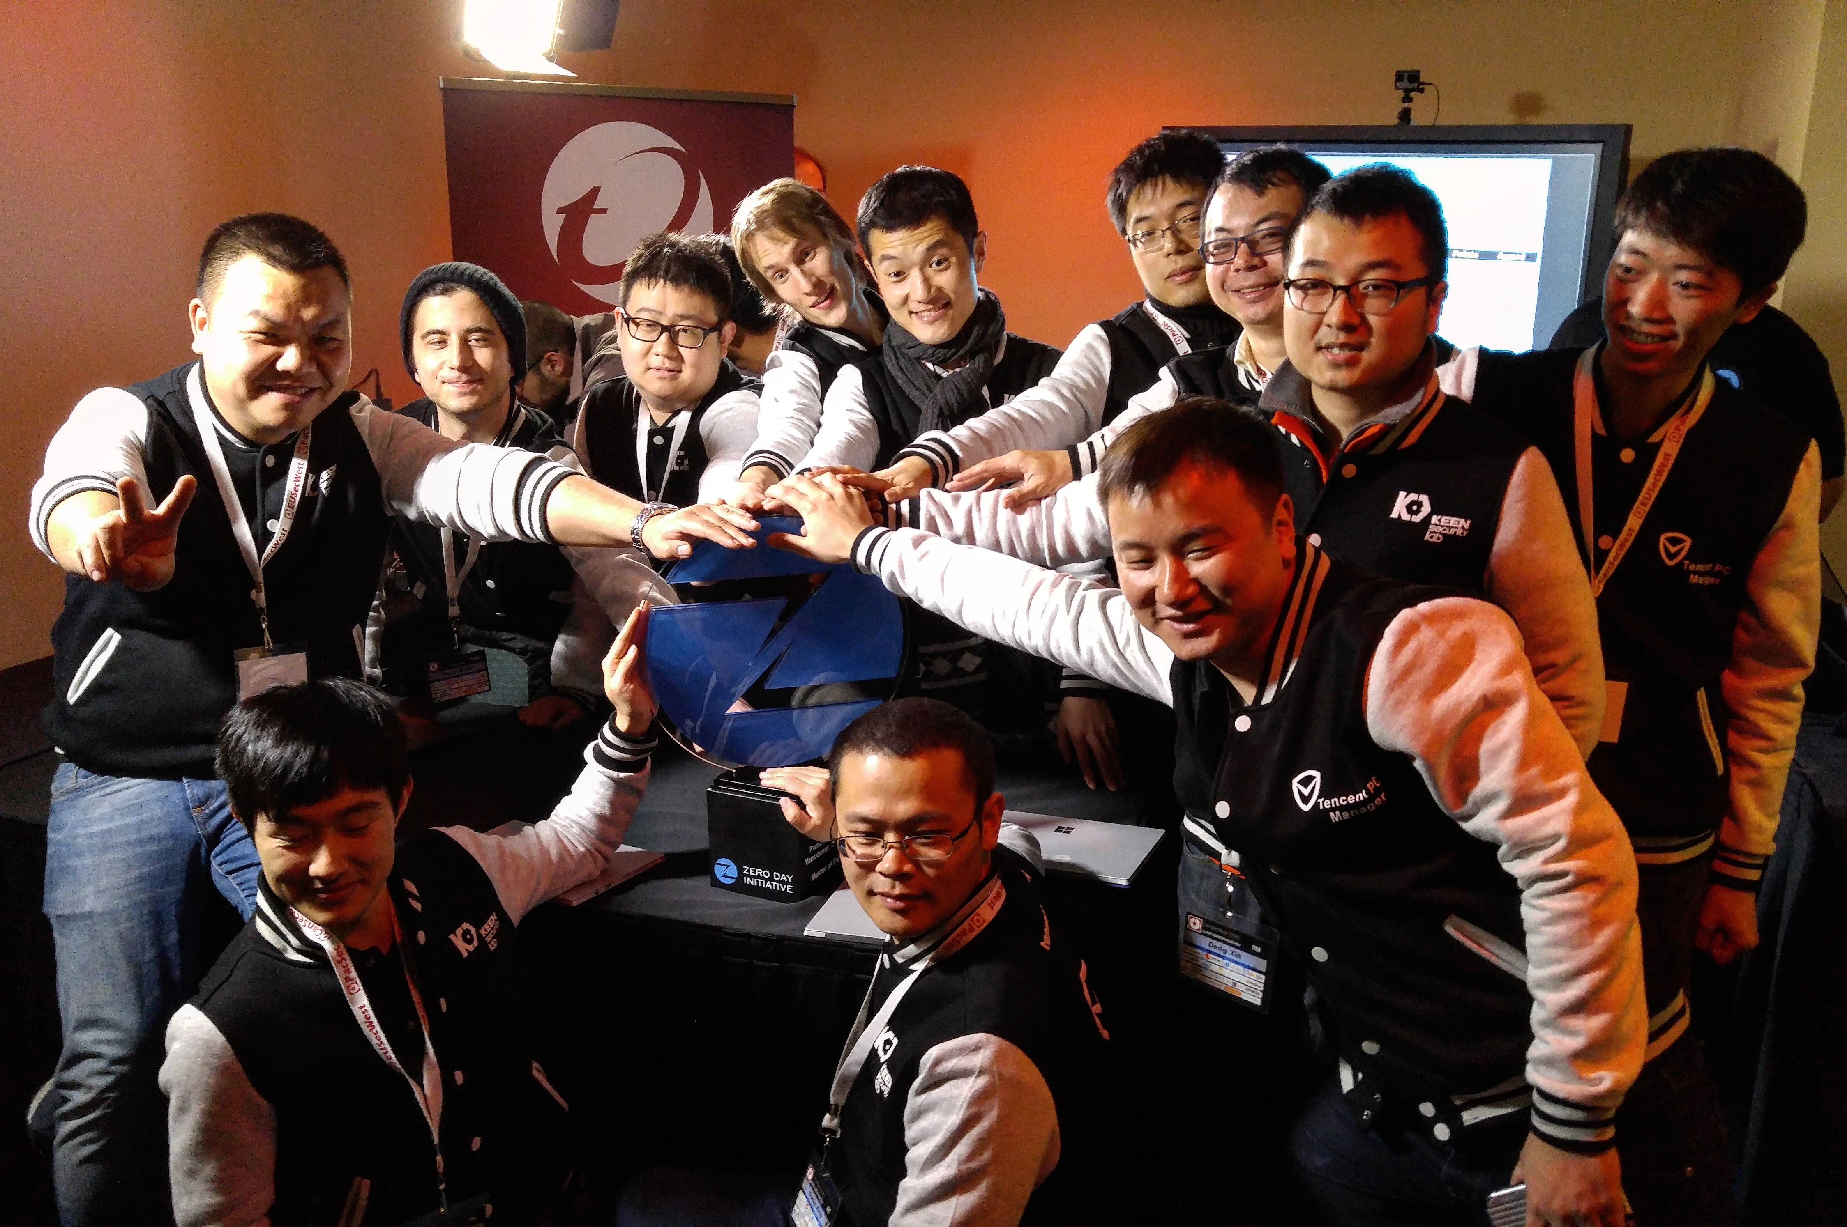

General Purpose Exploitation
Has Been Getting Harder
2010
2016
Notes:
We know that general purpose exploitation has been getting harder as you can see from, for example, the rapid growth in team sizes for Pwn2Own. Whereas in 2010 a single individual could come out victorious these days it takes a double-digit team of very skilled hackers.

Slide 18

What About Embedded?
Notes:
So what about the embedded world in that regard?

Slide 19

Right…
Notes:
Yeah, right…. no such luck

Slide 20
RTOS Exploit Examples
Name | Target | Type | RTOS | Mitigations
BroadPWN / CVE-2017- 9417 | Broadcom WiFi | Heap Buffer Overflow | VxWorks | NO
CVE-2017-0561 | Broadcom WiFi | Heap Buffer Overflow | VxWorks | NO
VxWorks DHCP / DNS | VxWorks DHCP / DNS Client & Server | Heap / Stack Buffer Overflow | VxWorks | NO
CVE-2015-7599 | VxWorks RPC | Integer Overflow | VxWorks | NO
CVE-2010-3832 | Intel/Comneon Baseband | Heap Buffer Overflow | ThreadX / Nucleus+ | NO¹
Qualcomm UMTS AUTN | Qualcomm Baseband | Stack Buffer Overflow | REX | NO²
¹ XMM6180 on iPhone4 has DEP, see ‘All Your Baseband Are Belong To Us’
² Newer Qualcomm chips run BLAST RTOS w. stack cookies / DEP / kernel-user separation, see ‘Baseband Exploitation in 2013’
Notes:
Consider for example some recent and not-so-recent exploits against systems running an RTOS. Whether it’s WiFi chips or basebands, in none of the cases were any exploit mitigations whatsoever present which greatly eases exploitation.

Slide 21

Quantitative Analysis
Notes:
So in order to get a more complete picture of the current state of embedded exploit mitigations I performed a quantitative analysis.

Slide 22
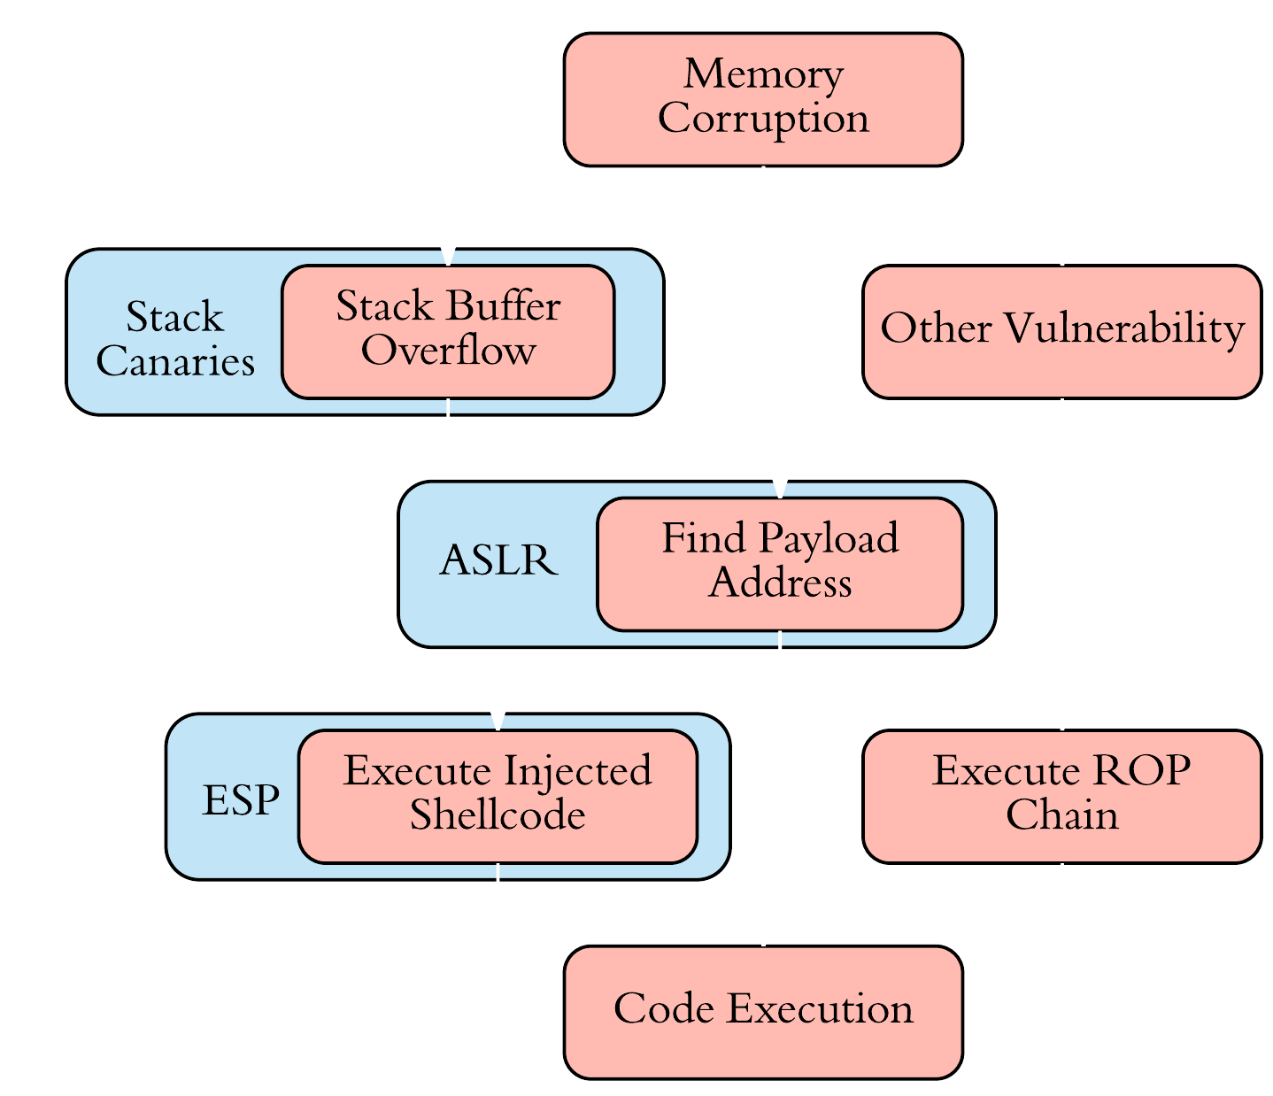
Minimum
Mitigation Baseline
ESP / DEP / NX / W^X
Non-exec. data memory
ASLR
Address Space Layout Randomization
Stack Canaries / SSP
Stack buffer overflow protection
Notes:
Here I chose a minimum baseline consisting of executable space protection, also referred to as DEP or NX, address space layout randomization and stack canaries because they are complementary and have a long history as the bread & butter of general purpose mitigations.

Slide 23











Operating System Selection
Selected 45 Popular Embedded Oses
High-end, Low-end, Linux/Windows/BSD-based, proprietary, etc.
Evaluated Support For
Mitigation Baseline
Optimistic Assesment
Notes:
I selected 45 popular embedded operating systems ranging from high-end to low end ones and from linux-windows or bsd-based ones to proprietary ones and evaluated them for support for this baseline.
The assessment is an optimistic one because I marked support as present if it was available for at least one architecture, regardless of implementation quality.

Slide 24
Notes:
So when you look at support for mitigations you can see that if we consider all operating systems in our selection support is already quite flaky but when you start eliminating mobile operating systems (for smartphones and such) and the ones not derived from windows, linux or BSD you can spot a steady downward trend with deeply embedded systems OSes (which are mostly RTOSes) having almost no support for any of the mitigations.

Slide 25
What’s Going On Here?
Notes:
So what’s going on here? Why is this the case?

Slide 26
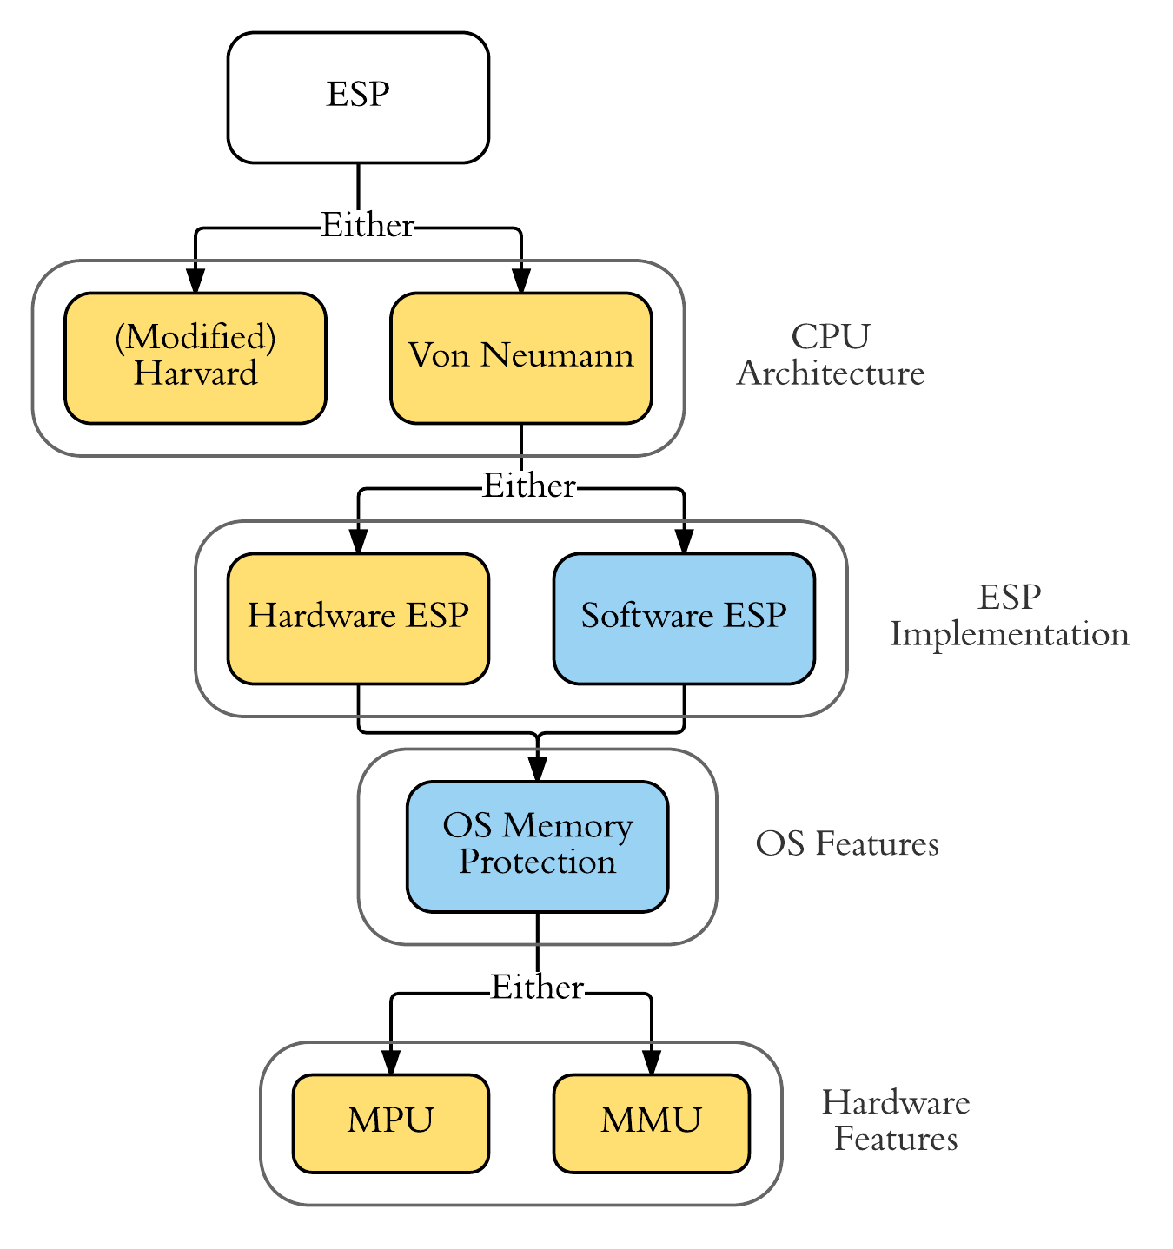
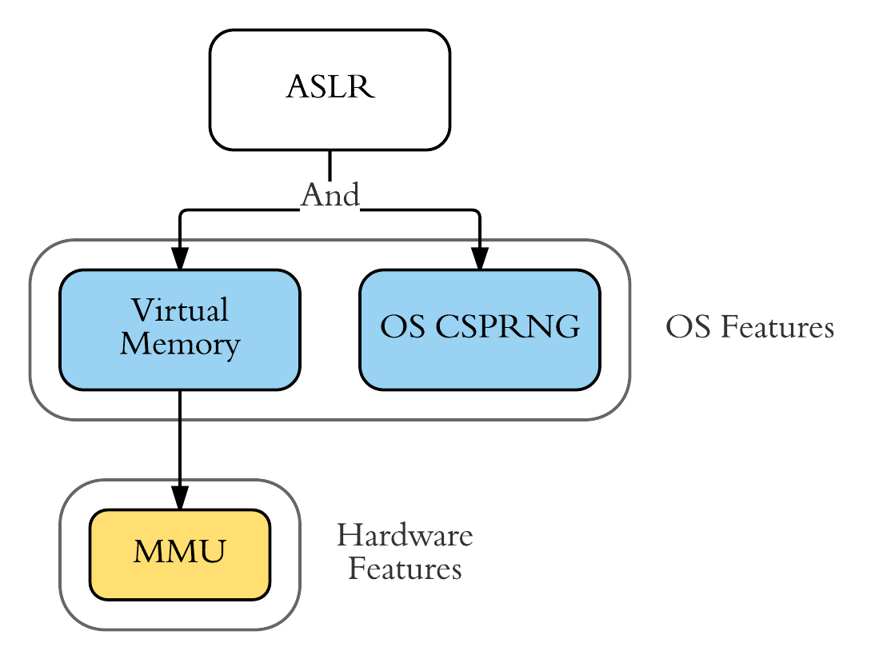
Hardware & Software Dependencies
Notes:
Well, first of all there are the hardware and software dependencies.
For ESP you need either a Harvard architecture where it is trivially present by design since code and data memory are separate. On a von Neumann one where this sesparation does not exist you need either hardware support or fully implement it in software (which comes with overhead). In both cases you will need memory protection support on part of the OS and a memory protection unit or memory management unit to support all the above.
For ASLR you will need virtual memory support to ensure processes have their own isolated private address space and prevent shared memory conflicts and an operating system secure random number generator to properly and securely randomize the objects. You also need an MMU in the hardware to support the virtual memory.

Slide 27
Notes:
So if we look at the support for the software dependencies among our selection we can see the same downward trend, especially when virtual memory and OS CSPRNGs are considered.

Slide 28













Hardware Selection
Selected 78 Popular Embedded ‘Core Families’
Evaluated for Hardware Dependency Support
Notes:
In order to evaluate hardware dependency support, I selected 78 popular embedded ‘core families’ of various architectures and evaluated them.

Slide 29
Notes:
As you can see from the slide, a little over 40% had hardware ESP support while a little under 50% had MMU support, with a little over 10% having MPU support. So we can see that even disregarding software dependency support there’s quite a lack of hardware dependency support.

Slide 30

Embedded Mitigation Challenges
Notes:
But these dependencies are not the only issues, there various other challenges as well which stand in the way of widespread embedded mitigation adoption.

Slide 31
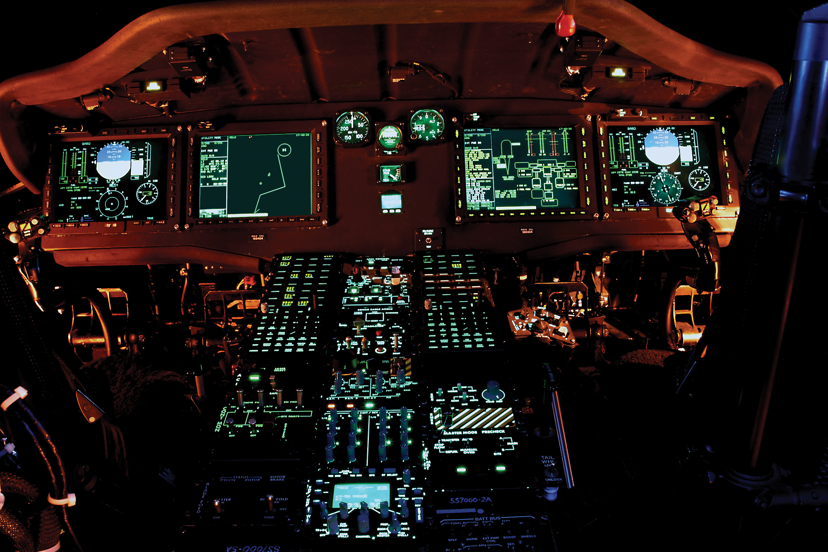
Resource & System Constraints
Limited Resources
Overhead influences adoption likelihood
Availability Requirements
Guarantee high system uptime
Real-Time Conflicts
Issues with eg. virtual memory caching, page faults, etc.
Notes:
First of all there are the resource and system constraints. As we know embedded systems are limited in resources such as code and memory size and computing power and any overhead imposed by mitigations influences the likelihood of adoption.
And then there’s availability requirements, many critical systems need to guarantee high system uptimes so any mitigations which might shut the system down in response to an attack are incompatible here.
And finally there’s the conflicts with real-time requirements. Dependencies like virtual memory with its caching and page faults introduce a degree of non-determinism that can undermine the real-timeness of the system.

Slide 32
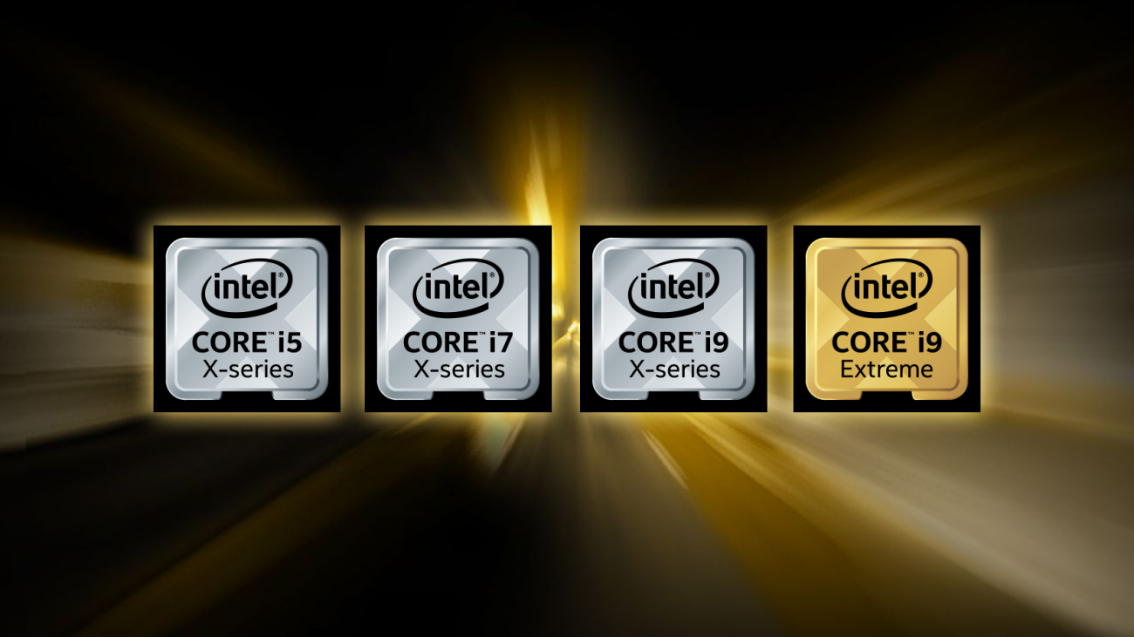
Advanced Processor Features
Modern mitigations increasingly
use advanced processor features
eg. SGX, MPX, CET, LBR, PMU
Only for modern high-end CPUs
Embedded HW diversity ->
OS cannot assume support
Notes:
We also cannot count on advanced processor features like we can do in the general purpose world. Many modern mitigations increasingly use advanced processor features which are only available for modern high-end CPUs.
Besides, the incredible hardware diversity in the embedded world means that an operating system cannot just assume a rare hardware feature is supported even if some processors would.

Slide 33

Embedded
Random Number Generators
Secure Randomness is OS Service!
Hardware Diversity -> Little Entropy Source Omnipresence
Low Entropy Environment
- Little / predictable activity
- “Boot-time Entropy Hole”
- Can’t wait for entropy too long..
Result: not-so-random NGs, bad workarounds*
* Wheel of Fortune – Jos Wetzels, 33C3, 2016
Notes:
And finally, there’s the issues with embedded random number generation which is a dependency of various mitigations.
It is important here to treat secure randomness as an operating system service, we can’t just say “oh, just use TinyCrypt or mbed TLS and figure out the seeding yourself” to developers
The OS usually also cannot assume that an entropy source present on one platform is present on all platforms which makes domain-specific designs less useful. Common sources in the general purpose world such as mouses or keyboards are absent for example.
And finally, embedded environments are generally low entropy: there’s often little or very predictable activity going on, especially at boot time when a lot of hardware still has to be initialized and the device isn’t really interacting.
This leads to the so-called boot-time entropy hole which is especially dangerous if you consider that many cryptographic materials and mitigation secrets are generated at that moment.
But you can’t wait too long for entropy either because that would slow down system startup…
The result is that we have a lot of not-so-random number generators and bad work arounds in the embedded world, some of which I discussed in my talk at last year’s CCC.

Slide 34

RTOS Mitigation Examples
Notes:
So, to see how these challenges affect currently existing mitigations, let’s take a look at some examples in actually existing RTOS mitigations

Slide 35
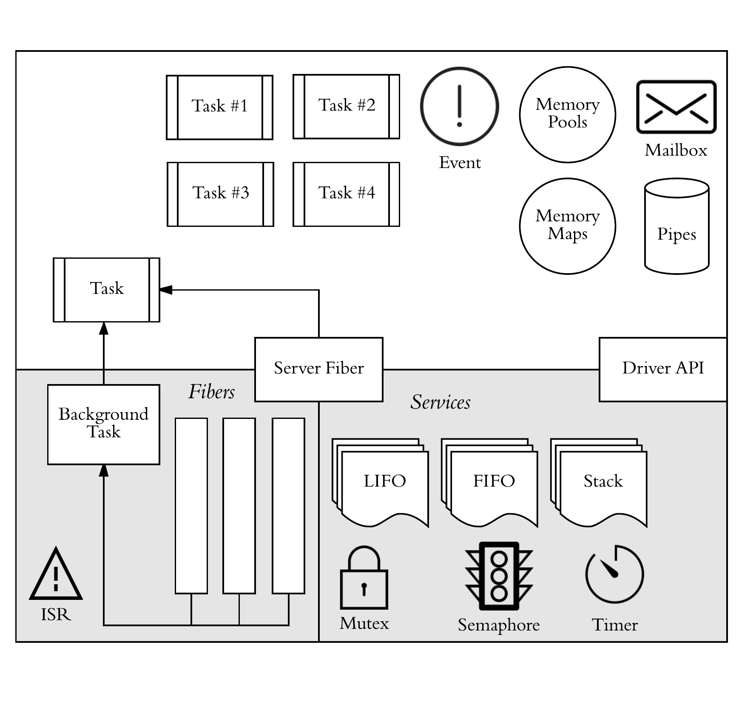





Library based RTOS
Based on Wind River Rocket
OS Linux Foundation Project
Aimed at resource-constrained IoT
Young (2016) but promising
Input from major chipmakers
Explicit focus on security
Notes:
Let’s start with Zephyr which is a library-based RTOS based on Wind River Rocket. It’s an open source linux foundation project aimed at resource-constrained IoT devices and it’s young but promising since it has input from major chipmakers and an explicit focus on security.

Slide 36
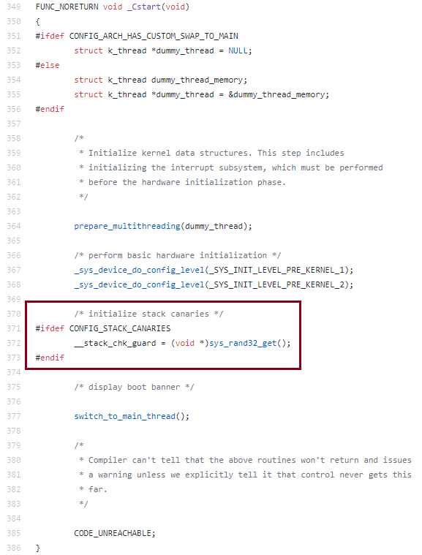
Zephyr
Stack Canaries
Based on Clang/GCC SSP
Canary Failure -> System Error
One master canary for entire address space
Generated once at system boot
No refreshing
Generated using RNG API
Implementation depends on chosen random driver
Notes:
Currently Zephyr only has one mitigation, namely support for stack canaries. It’s stack canary mechanism is based on the Clang/GCC stack smashing protector scheme but is modified so that a canary mismatch invokes a system error and there is a single master canary for the entire address space. This master canary is generated once at system boot, as you can see on the left of the slide and never refreshed. Generation is done using the RNG API the implementation of which depends on the chosen random driver.

Slide 37
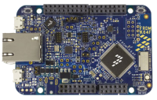
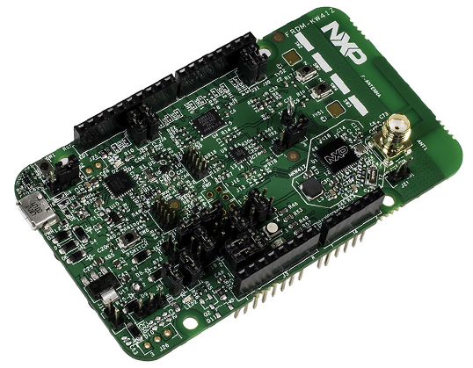
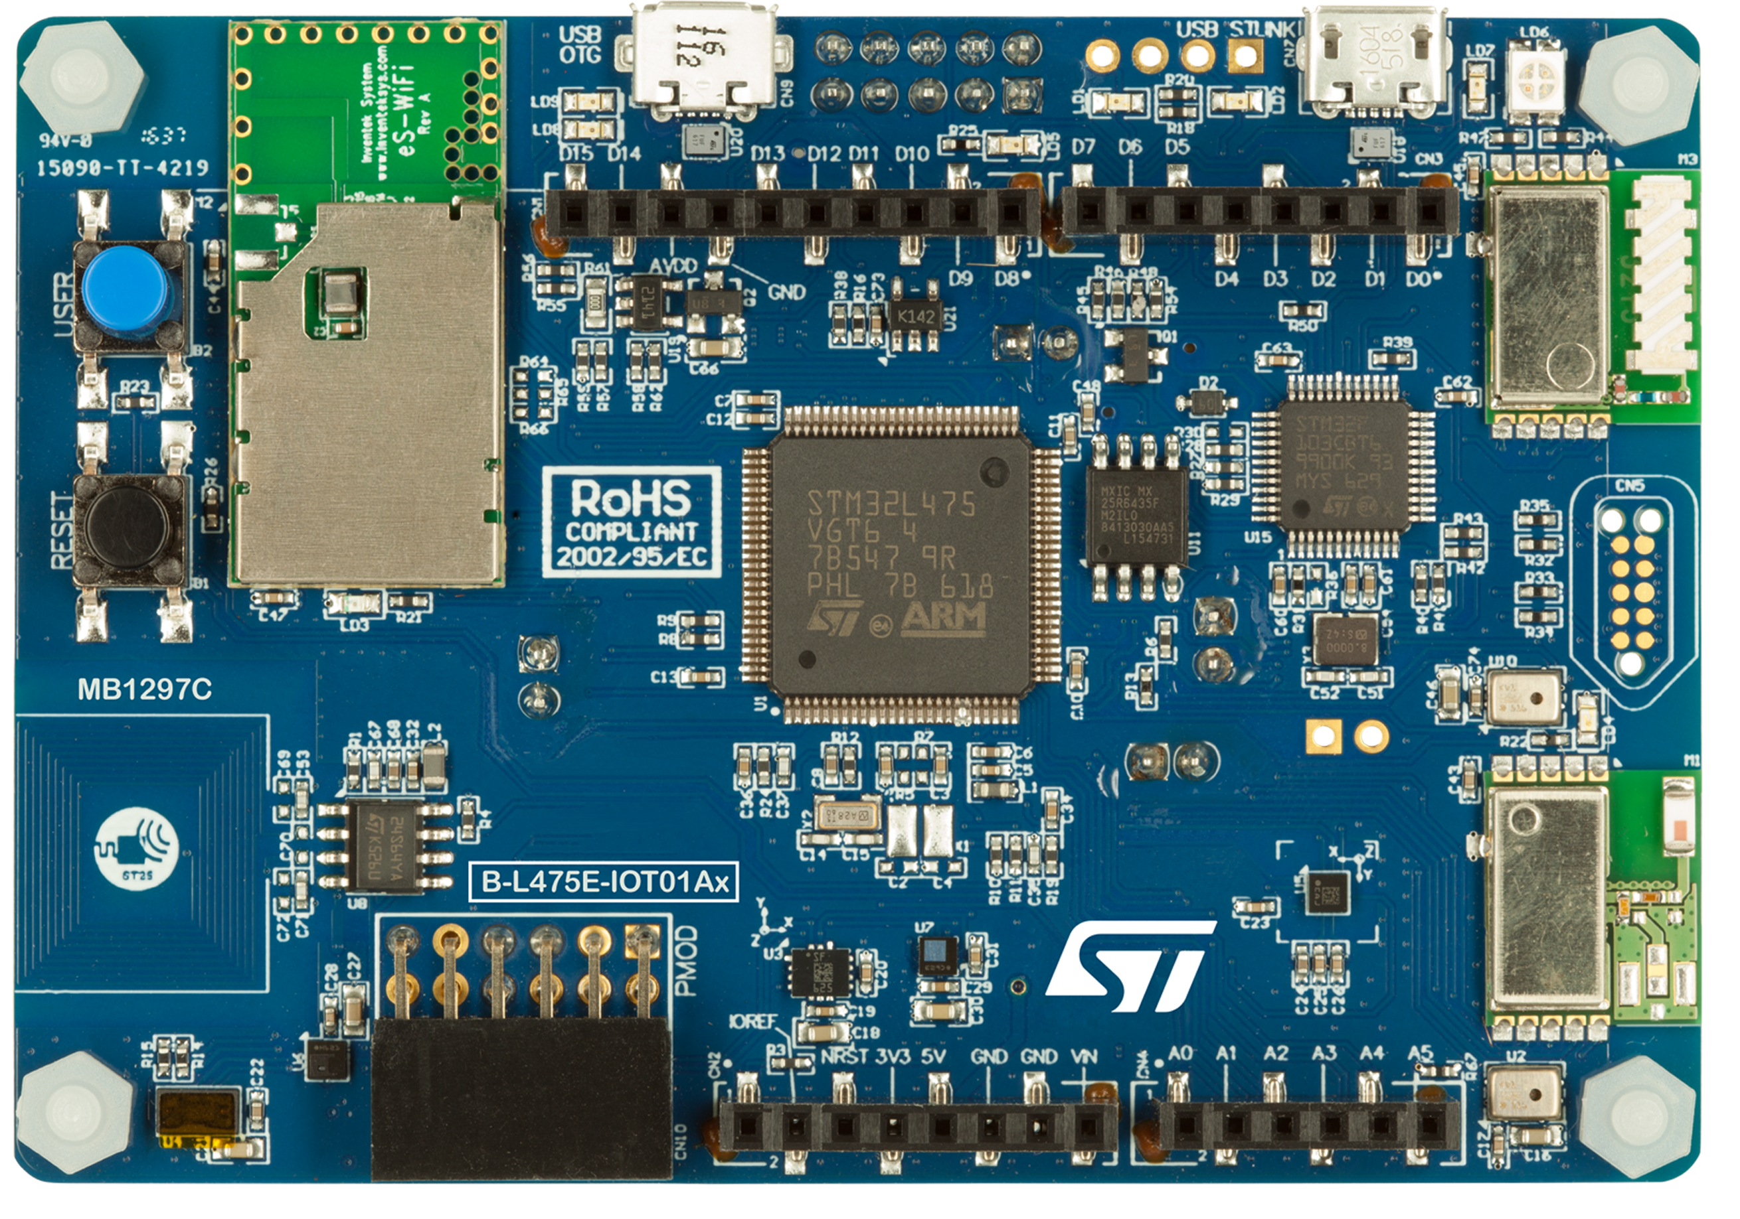
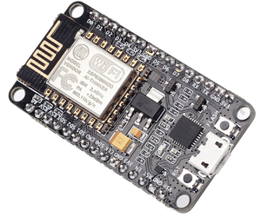
Zephyr Random API
RANDOM_HAS_DRIVER (TRNG)
RANDOM_MCUX_RNGA
NXP Kinetis K64F
RANDOM_MCUX_TRNG
NXP Kinetis KW40Z & KW41Z
RANDOM_STM32_RNG
STM32 Boards
RANDOM_ESP32_RNG
ESP32 Boards
(requires Wi-Fi & Bluetooth enabled)
Notes:
There are two main approaches with Zephyr here, the first is a true random number generator one where a driver for a specific board’s TRNG is accessed by the RNG API. Currently there are only drivers for a few of the supported boards such as some NXP Kinetis models and some STM32 and ESP32 boards.

Slide 38
TRNGs Among Zephyr 1.8 Supported Boards
Notes:
And if we look at the boards supported by Zephyr then we can see that even if drivers were available for all boards with TRNGs, not all of the Zephyr supported boards have a TRNG.
In fact, only a little over half have one and of those a disproportionate amount are ARM based boards.
This means that a lot of boards will have to rely on a pseudo-random number generator instead for canary generation.

Slide 39

Zephyr Random API
TEST_RANDOM_DRIVER (PRNG)
X86_TSC_RANDOM_GENERATOR
Uses x86 RDTSC
Canary 1st value drawn from PRNG
little difference between bootruns
Infoleaks everywhere
TIMER_RANDOM_GENERATOR
Suffers from similar issues
Had contact with Zephyr team, plans to integrate OS CSPRNG
Most likely NIST SP800-90A based
Notes:
And the trouble here is that Zephyr only offers insecure pseudo-random number generator support.
The first of which draws on the x86 read timestamp counter instruction which is problematic because a) the canary is the very first value drawn from the PRNG which results in little difference between bootruns and b) the timestamp counter value is used everywhere in public fields such as in network packets which means there are infoleaks everywhere.
The second option is very similar to the first but uses a more generic internal timer which suffers from all the same problems.
I’ve been in contact with the Zephyr team and fortunately they now have plants to integrate an operating system CSPRNG in future releases, most likely one based on the NIST SP800-90A standard

Slide 40

Fuchsia OS
Under-development Google RTOS
Pushed to github w/o official statement in August 2016
Seems intended for IoT to smartphones
Based on Magenta microkernel
Derived from LK (Little Kernel)
Virtual Memory / MMU support
Kernel- / Userspace Separation
Notes:
The second OS I’d like to look at is the mysterious Fuchsia operating system. It’s an under-development RTOS by google which was pushed to github without official statement in august of 2016 and seems intended for the whole embedded space from IoT devices to smartphones.
It’s based on the Magenta microkernel which is derived from LK (Little Kernel) and has virtual memory and MMU support as well as kernel- / userspace separation.

Slide 41
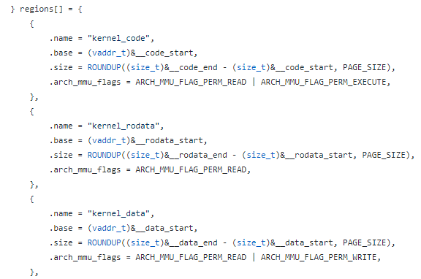
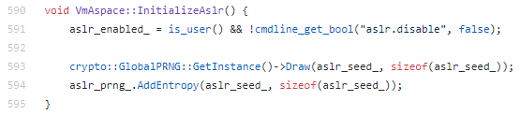
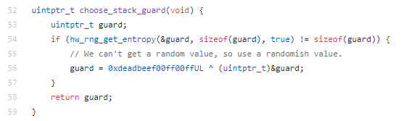
Fuchsia OS
Exploit Mitigations
ESP / DEP
x86 MMU-based DEP policies
ASLR
All executables PIE by default
Randomization draws on OS CSPRNG
Stack Canaries (GCC SSP Model)
Single early-boot global canary
Canary generated using HW RNG API
Static value fallback
Canary failure -> kernel panic
Notes:
The good thing to note is that it seems they’re really making work of supporting all mitigations in the baseline.
They have ESP / DEP support but only for x86 CPUs with an MMU.
They also have ASLR support which sets all executables to be position-independent by default for full-ASLR compatibility. Randomization draws upon a secure OS RNG as well.
I’m not sure how they reconcile virtual memory support with real-time requirements however, it’s possible that this requires disabling VM support which would mean ASLR is disabled as well.
Finally there’s stack canary support as per the GCC SSP model. Here a single early-boot global canary is generated using a hardware rng API. If it cannot get a random value from the hardware RNG API, for example if there is no on-board TRNG, it will use a static fallback value which is a significant weakness.
And here too a canary failure means a kernel panic is invoked which is a little inflexible for high-availability systems.

Slide 42

Academic Mitigation Examples
Notes:
I’d also like to briefly look at two mitigation examples from academia to further highlight some of the pitfalls in mitigation design for deeply embedded systems.

Slide 43
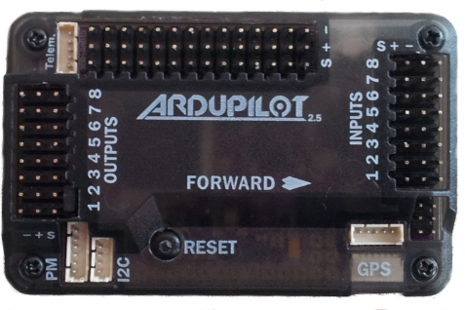
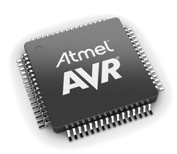
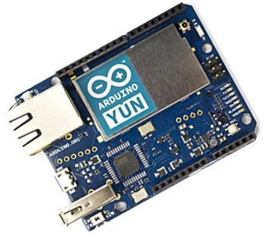
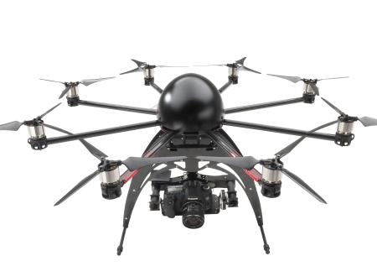
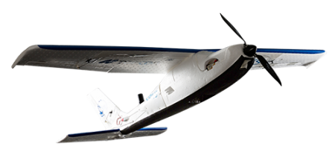
MAVR* & AVRAND**
Boot-Time Code Diversification
MAVR: Ardupilot UAV system
AVRAND: AVR chip in Arduino Yun
MAVR requires hardware mod
Additional master processor + flash chip
(Re)Randomize by re-flashing
Every N restarts or after crash
Attacker can reduce device lifespan by forcing re-flash to exhaust program / erase cycles
* MAVR: Code Reuse Stealthy Attacks and Mitigation on Unmanned Aerial Vehicles – Habibi et al. (2015)
** AVRAND: A Software-Based Defense Against Code Reuse Attacks for AVR Embedded Devices – Pastrana et al. (2016)
Notes:
The examples I’d like to touch upon are MAVR and AVRAND. Both are boot-time code diversification schemes for the AVR architecture. MAVR is designed for the Ardupilot UAV system while AVRAND was designed for the AVR chip in the Arduino Yun board.
One downside of MAVR is that it requires significant hardware modification: an additional master processor and flash chip which decrease its adoption likelihood.
But the real problem with both is that they re-randomize memory by re-flashing the diversified firmware either every N restarts or after a crash has occurred.
The danger here is that an attacker can actually use this mechanism as an attack vector by reducing the device lifespan by forcing re-flashes through crashes or software restarts to exhaust the flash memory’s program / erase cycles.
Stuff like this is something you really need to keep in mind when designing mitigations for embedded systems and another hurdle in boot or runtime memory randomization.

Slide 44

Deeply Embedded
Exploit Mitigation Criteria
Notes:
So now that we have seen why it’s so hard to adopt mitigations in deeply embedded systems and how these challenges affect those rare RTOSes which do adopt them, let’s take a look at what the criteria are, in my opinion, for successful deeply embedded exploit mitigations.

Slide 45
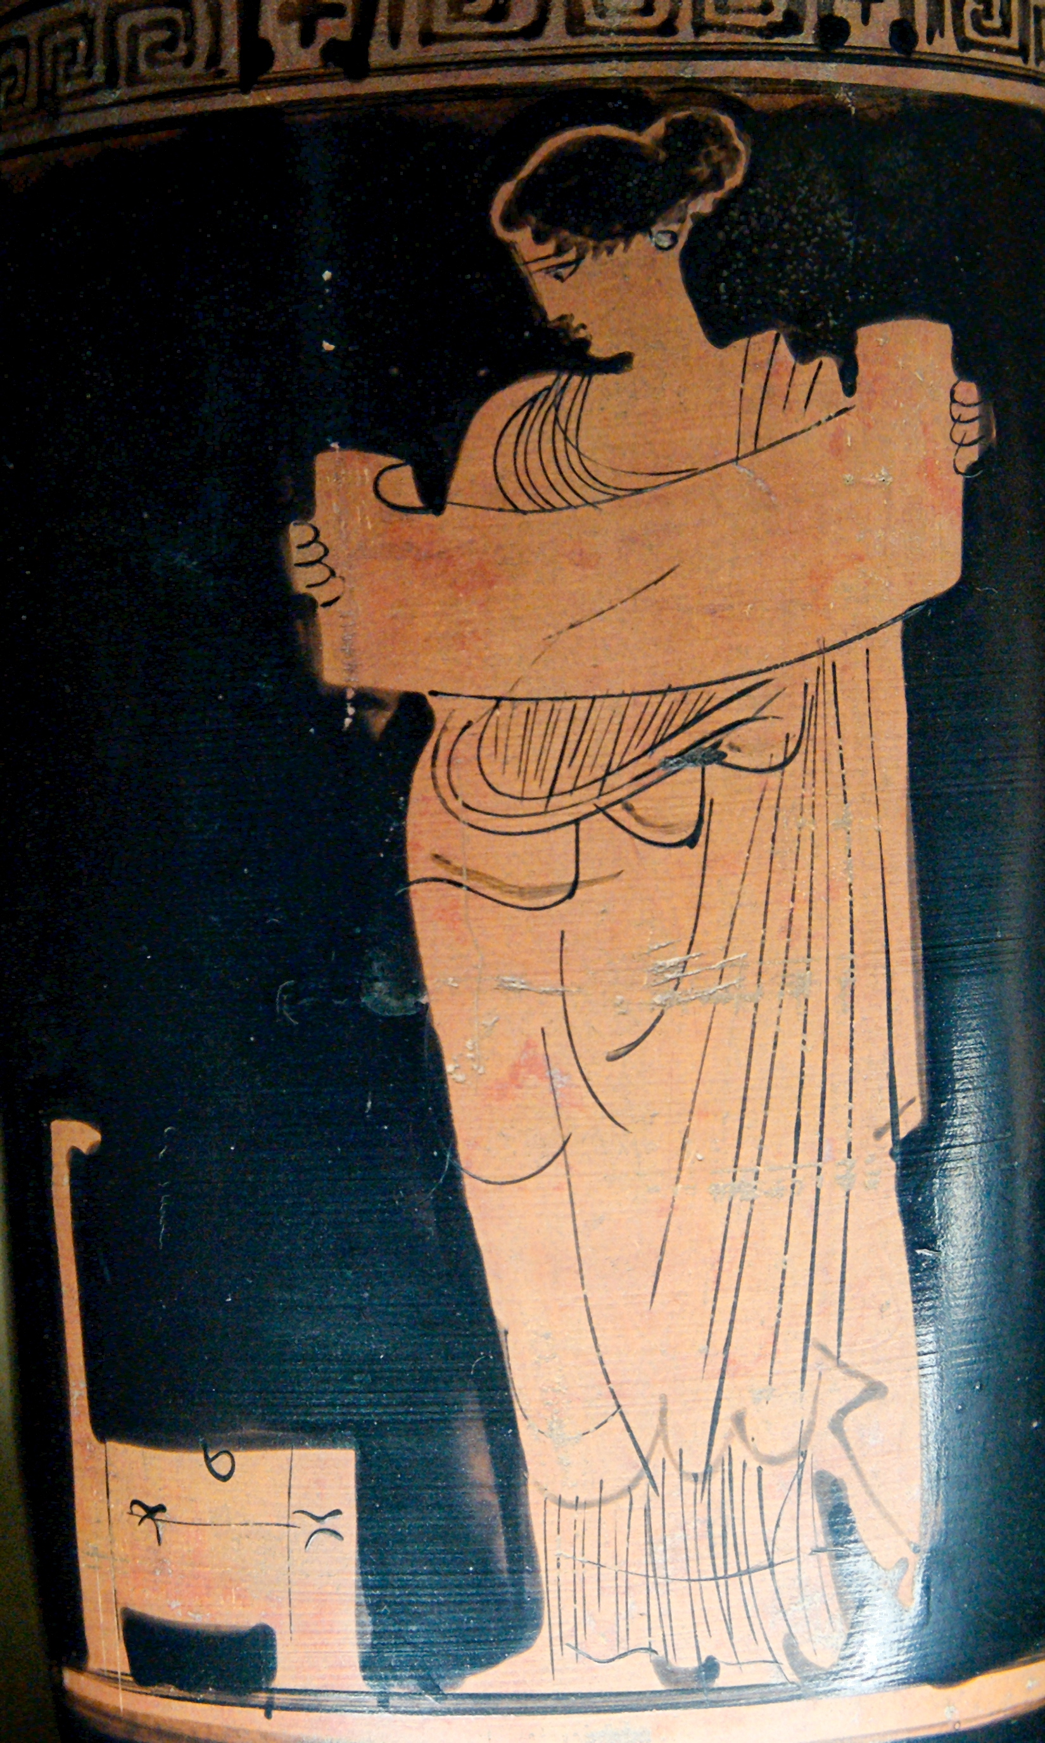
Embedded Exploit Mitigation Criteria
Low Resource Pressure
Max 5% Overhead*
Hardware Agnostic
Availability Preservation
‘Real-Time Friendly’
Easy RTOS Integration
* Microsoft BlueHat Prize Rules (2012),
‘SoK: Eternal War in Memory’ – Szekeres et al. (2013)
Notes:
When it comes to the mitigations themselves the first criterium is low resource pressure, a maximum of 5% overhead across metrics seems to be a reasonable upper bound based on looking at prior work.
Secondly it needs to be hardware agnostic, so no reliance on special hardware features.
We also need availability preservation, so mitigation policies should be modular in their responses to detecting an attack and allow for some responses which let the system continue running if at all possible.
Next “real-time friendliness” is important, so we should avoid non-deterministic code as much as possible.
And finally the mitigations should be relatively easy to integrate into existing RTOSes without requiring major design overhauls.

Slide 46

Embedded OS CSPRNG Criteria
Low Resource Pressure
Use lightweight crypto
Entropy Gathering Limitations
Rapidly available upon boot
No constant runtime polling
Non-Domain Specific Entropy Sources
No reliance on sensor values, accelerometers, etc.
Notes:
Since embedded OS rngs are such an important dependency of many mitigations it’s important to look at their criteria as well.
Here too we should focus on low resource pressure by using lightweight cryptographic schemes and primitives.
Secondly we need to take entropy gathering limitations into consideration, we need to have a lot of seed entropy be rapidly available upon system boot to avoid the so-called ‘boot-time entropy hole’ without slowing down system startup.
We also should avoid constant runtime polling for additional entropy because of the power consumption.
And finally we need to use non-domain specific entropy sources, so no reliance on sensor values, accelerometer readings or other sources that aren’t more or less universally present.

Slide 47
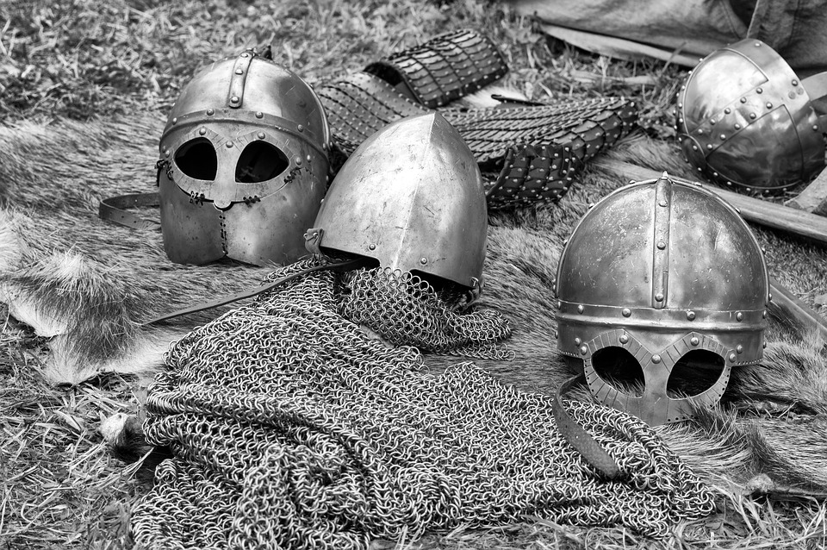
μArmor
Notes:
And this brings me to the final part of my talk: a discussion of uArmor.

Slide 48
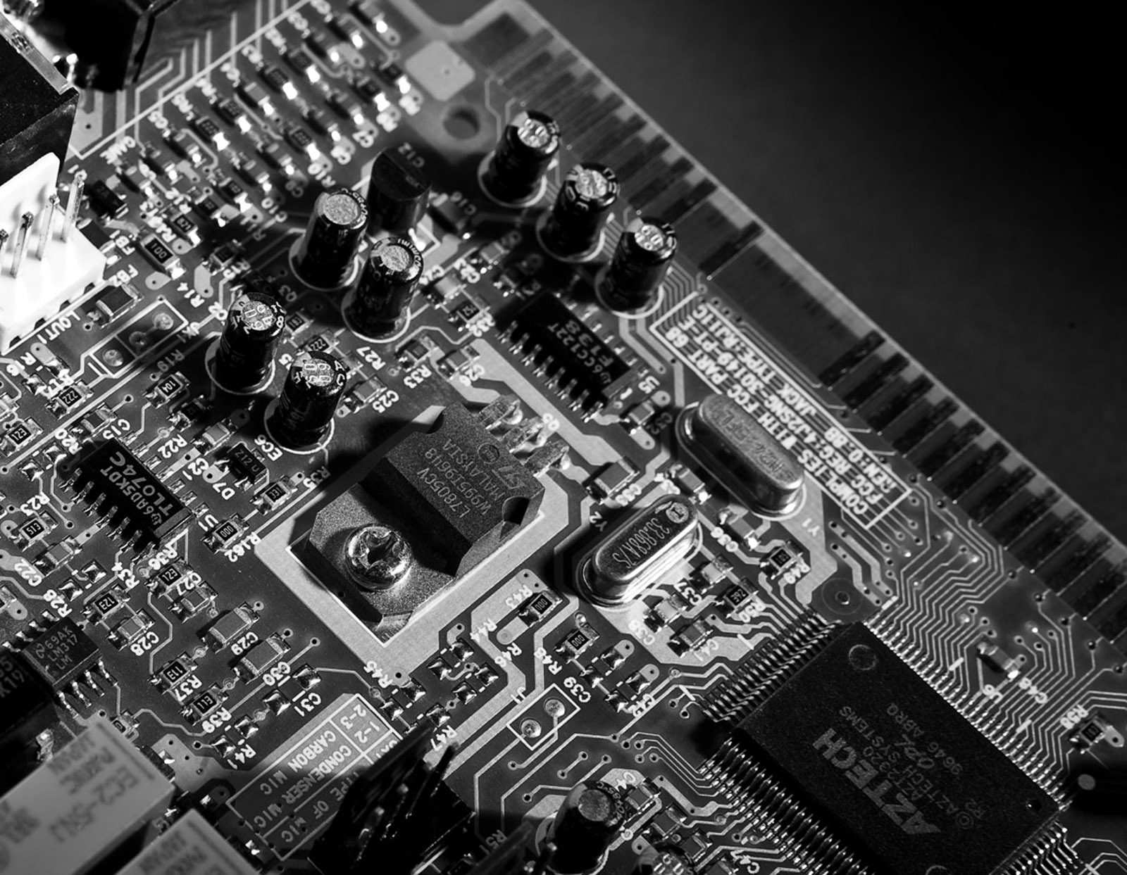
μArmor
Deeply Embedded Mitigation Baseline
μESP + μScramble + μSSP + μRNG
Target Systems
Harvard or VNA CPU w. HW ESP
Single-address space (RT)OS or bare metal
Attacker Model
Remote (eg. WiFi, Bluetooth, RF) control-flow hijacking attacks
Notes:
uArmor is a deeply embedded mitigation baseline I designed to meet the criteria we just discussed. It consists of uESP, uScramble to act as a replacement for ASLR, uSSP and a tiny OS RNG named uRNG.
It’s intended for systems with either a Harvard CPU or a von Neumann one with hardware esp support which run either a single-address space RTOS or are bare metal.
The attacker model it’s intended to guard against are remote attackers seeking to carry out control-flow hijacking attacks, so no attackers with physical access or the like.

Slide 49
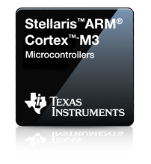
Representative Platform
Notes:
I implemented a proof of concept on a representative platform consisting of a texas instruments ARM Cortex-M3 microcontroller running the Zephyr RTOS.

Slide 50
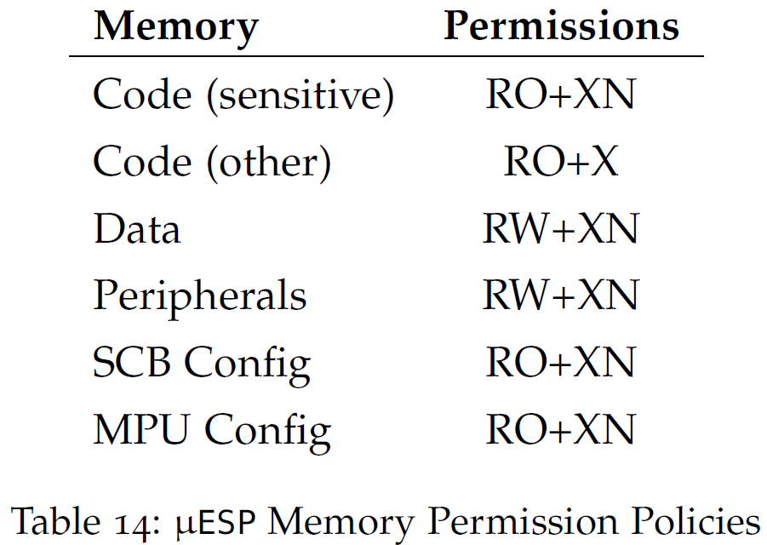
μESP
Use MPU to Enforce ESP
Stack Grows Away From Data
Limit Code-Reuse Surface
Prevent ret2bootloader style attacks
‘Lock Down’ MPU & SCB
Prevent MPU disabling
Notes:
The first component is uESP which uses the MPU to enforce ESP by making data non-executable and code read-only among other permission settings as shown in the table on the left.
It ensures the stack grows away from the data for safety reasons and limits the code-reuse surface by making sensitive code areas non-executable after running to prevent so-called return-to-bootloader style attacks.
Finally it locks down the MPU and system control block in order to prevent MPU disabling and SCB meddling by the attacker.

Slide 51
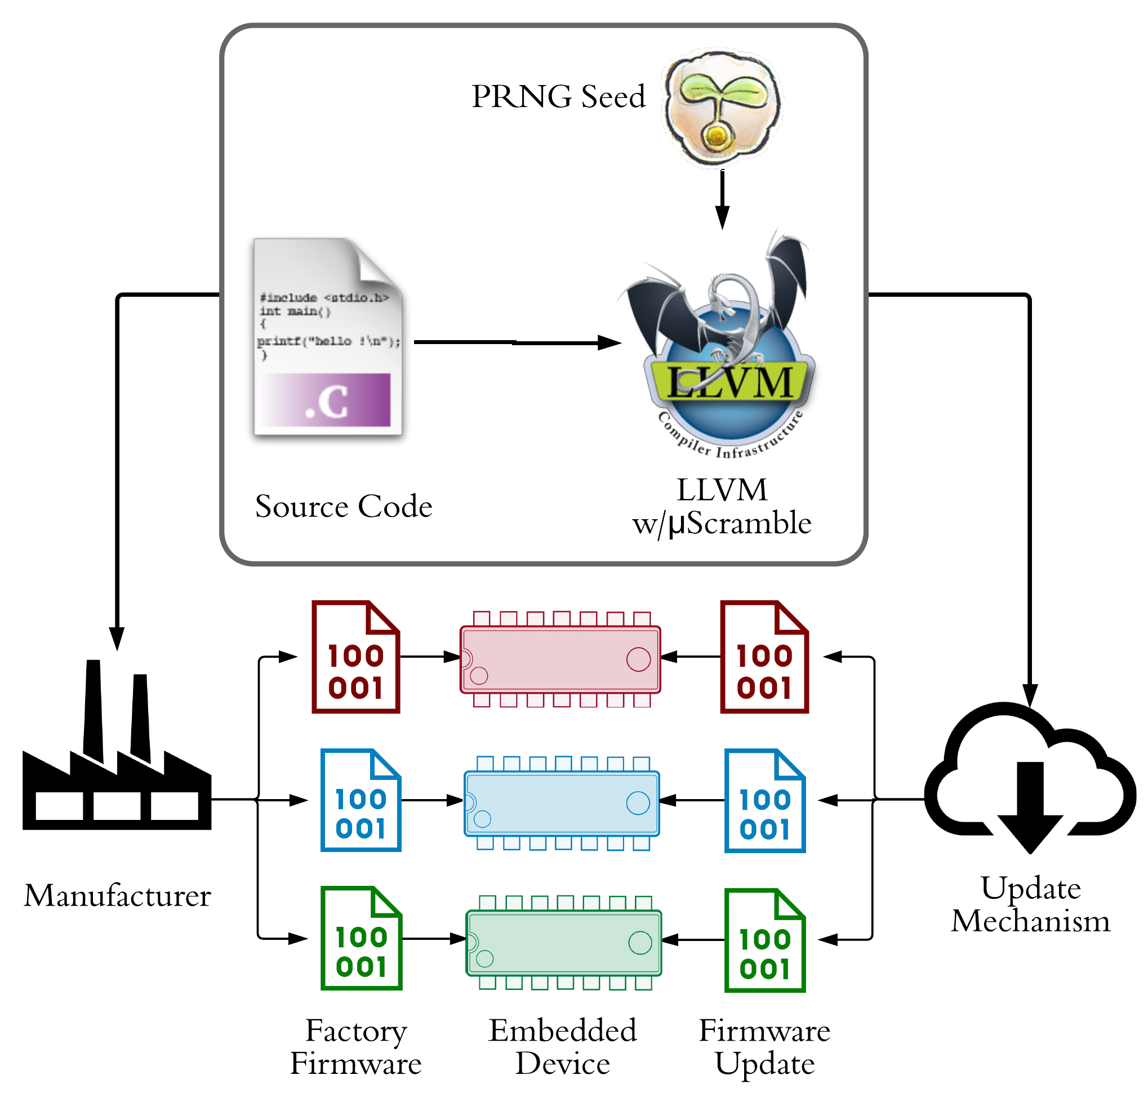
μScramble
Need Alternative for ASLR
Software Diversification
When: Compilation, Boot, Runtime, Etc.
What: Code, Data
Hybrid Compile/Update Solution
Integrated in firmware generation
Per-device diff firmware image
Benefits
Limited Overhead
No virtual memory required
Works on source: platform independent
Notes:
The second component is uScramble which seeks to offer an alternative for ASLR that does not need virtual memory.
Essentially ASLR is one strategy among many in the field of software diversification where we can decide when and what to diversify.
uScramble is a hybrid compile and update time solution which is integrated in the firmware generation process as part of the compiler as seen on the left and generates a per-device different firmware image during intial firmware loading and subsequent updates.
The benefits here are limited overhead because all diversification is done outside of runtime or boottime phases. We also don’t need virtual memory which is a major boon for deeply embedded systems and it works on the source-code so it is platform independent and transparent to developers.

Slide 52
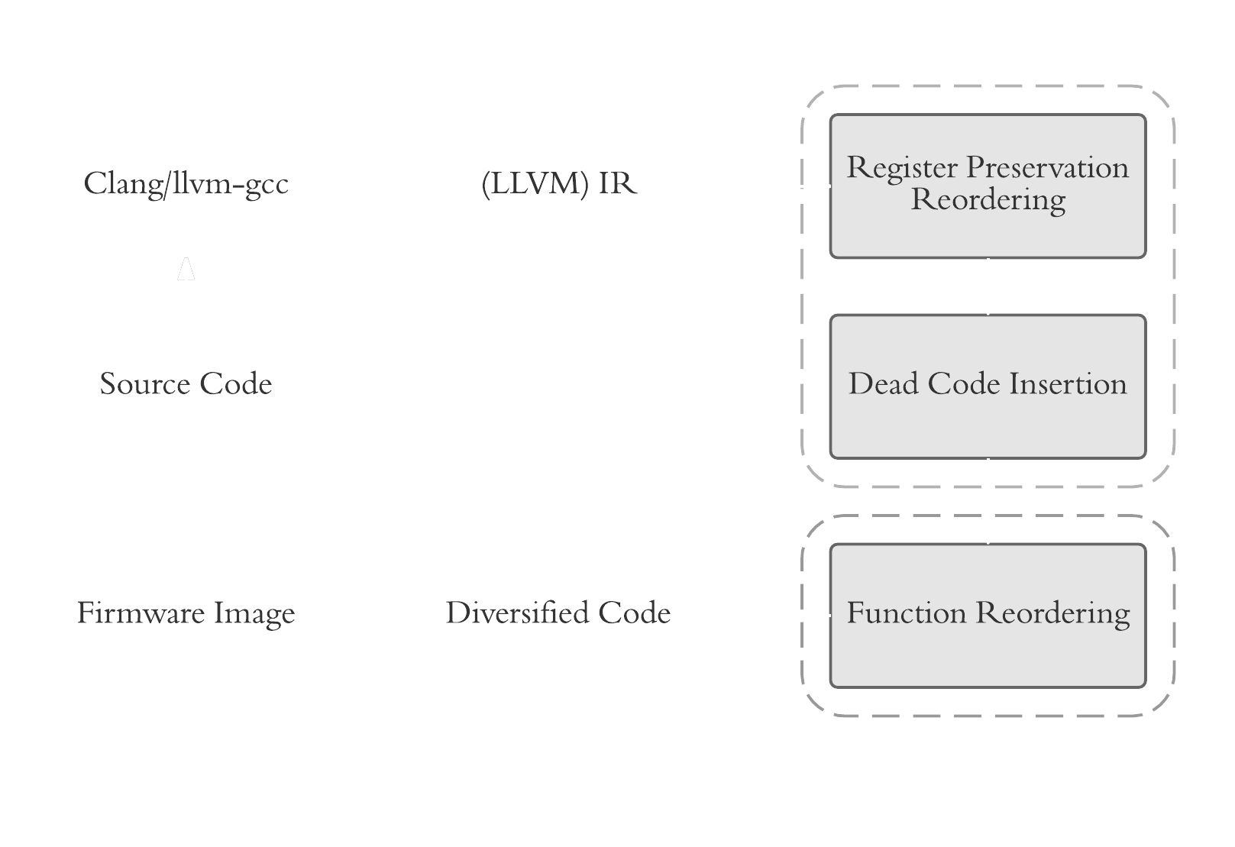
μScramble
Code Diversification
Code Transformations
Function Reordering
Dead Code Insertion
Register Preservation Reordering
Fine-Grained Randomization
Wrt. image base
Wrt. function base
Wrt. inter-function distance
Order of register preservation code
Decorrelation reduces infoleak & bruteforce impact
Notes:
The code diversification of uScramble is implemented in LLVM as a series of passes. There are three transformations being function reordering, dead code insertion and register preservation reordering.
The randomization is fine-grained because unlike ASLR it randomizes gadgets with respect to the image base, with respect to the function base and functions with respect to eachother. It also randomizes the order of so-called register preserving code.
This fine-grained nature means memory objects are decorrelated which reduces the impact of information leaks and bruteforce attacks.

Slide 53
μScramble
Transformations
….
Function 3
push edx
push esi
push edi
…
pop edi
pop esi
pop edx
ret
push edi
push edx
push esi
…
pop esi
pop edx
pop edi
ret
TRAP
TRAP
…
Function 1
Function 1
….
Function 2
….
Function 3
….
Function 2
Notes:
Here you can see the uScramble transformations. The first one is function reordering which shuffles around the order in which functions are laid out in the firmware image.
In this manner the offsets of functions with respect to the image base are randomized.
Next we grow the sizes of functions with dead code insertion to randomize the gadget offsets with respect to the function base as well as functions with respect to eachother. The dead code that is inserted is a series of TRAP instructions which invoke a violation handler when executed to trap would-be attackers.
Finally we randomize the order of register preservation code. This last thing we do because in code-reuse attacks such as ROP attacks many gadgets use the saving and restoring prologues and epilogues as part of register setting gadgets. By randomizing their order we break ROP chain assumptions about register layouts.

Slide 54
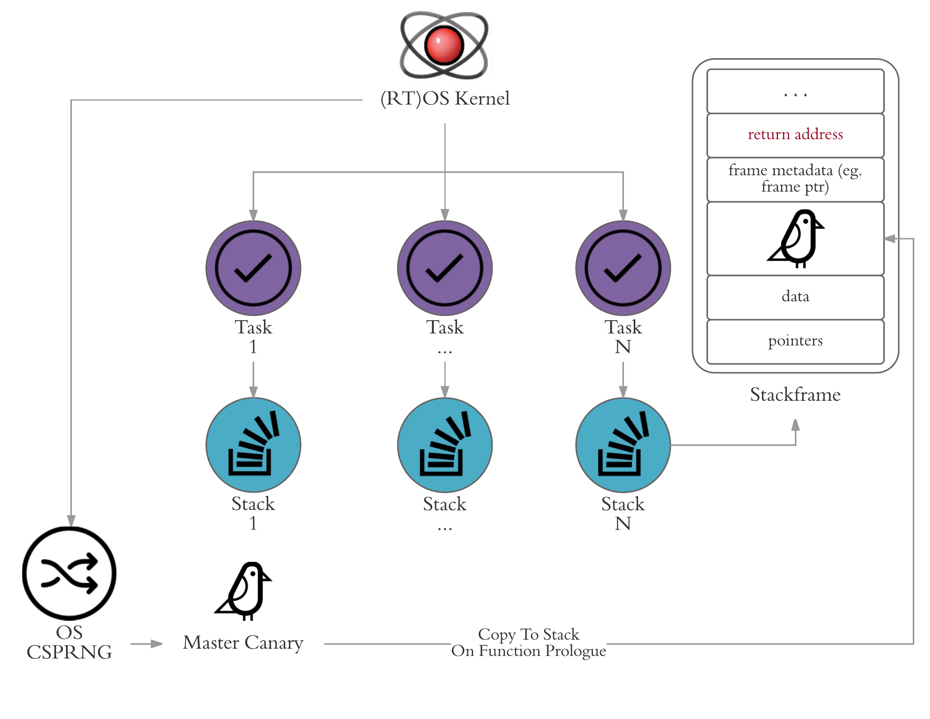
μSSP
Based on Zephyr SSP
Master canary drawn from OS CSPRNG
Modular violation handler
Passive
Fatal
Thread Terminate / Restart
System Terminate / Restart
Notes:
This brings us to uSSP which is relatively simple. It’s essentially the Zephyr SSP scheme but with the master canary drawn from a secure OS RNG and with a modular violation handler. This handler has several policies some of which allow for a degree of availability preservation. The first is a passive policy which simply allows the attack to continue while silently logging an alert, the second is the default Zephyr policy which invokes a fatal system error.
And finally we have the option to terminate or restart the violating thread or terminate or restart the entire system.
The suitability of such policies differs per device and is up to system integrators.

Slide 55
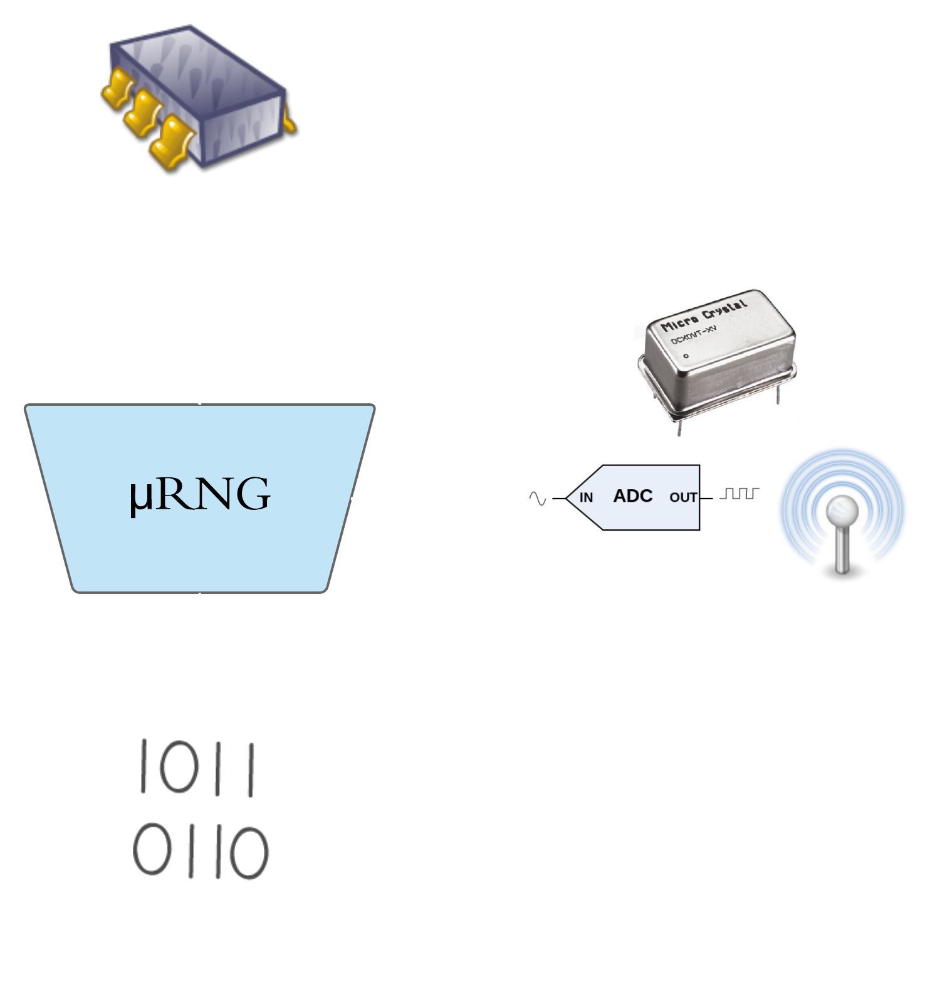
μRNG
Keccak-based OS CSPRNG
128-bit security
25 byte internal state
1 algorithm for entropy gather & RNG
Integrated as Zephyr random driver
Avoid Reseed Polling
Reseed Control linked to PRNG output
Notes:
Finally this brings us to uRNG which is a keccak-based os secure random number generator. It offers a 128 bit security level and has a 25 byte internal state. It uses 1 algorithm for both entropy gathering and random number generation to limit code size and is integrated into Zephyr as a random driver.
uRNG avoids reseed polling by linking the reseed control invocation to the PRNG output instead.

Slide 56
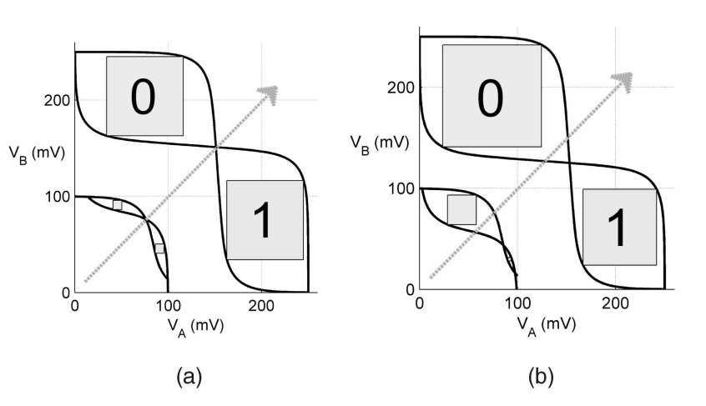
μRNG
Initial Entropy Source
SRAM Startup Values (SUVs)
Two stable states
Converge after initial instability
Manufacturing Differences
Biased cells -> PUFs
Random cells -> PRNGs
Many Benefits
Instantly available at very early boot
Differs between devices & bootruns
SRAM omnipresent on MCUs
* Power-Up SRAM State as an Identifying Fingerprint and Source of True Random Numbers – Holcomb et al. (2009)
Notes:
A very important part of uRNG is finding a non-domain specific initial entropy source. For this I chose to use SRAM startup values (SUVs).
Essentially SRAM cells consist of two cross-coupled inverters and their SUVs are unstable during powerup, converging after a brief period.
As you can see in the picture on the left, due to manufacturing differences, in some cases one inverter is significantly faster than the other leading to a biased SUV, a property commonly used in the design of physically unclonable functions.
In other cases, the bias is so small that the convergence is governed by environmental noise instead making it an ideal RNG seed source.
SRAM SUVs have many benefits because they are instantly available in large quantity in very early boot and they differ between devices and individual boot sessions.
On top of that, SRAM is omnipresent on almost all MCUs.

Slide 57

μArmor
Overhead & Security Evaluation
Notes:
So let’s take a look at the overhead and security evaluation of uArmor

Slide 58
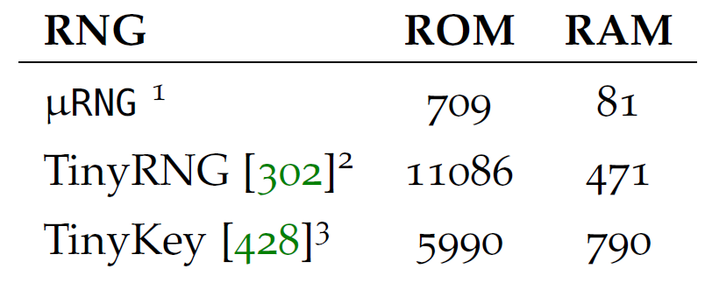
μArmor
Overhead Evaluation
Metrics
Code Size, Data Size, Memory Usage, Runtime Overhead
Evaluated Against
IoT sample applications
TACLeBench suite
Overhead
Code Size ≤ 5%
Others ≤ 1%
Notes:
I evaluated code, data, memory and runtime overhead of uArmor against a mix of representative IoT sample applications and an industry benchmarking suite named TACLeBench
The overhead with respect to total device resources was less than or equal to 5% for code size and less than 1% for all other metrics, thus meeting our goals.
And it is also worth noting that uRNG outperforms prior embedded PRNG work as seen in the table on the left.

Slide 59
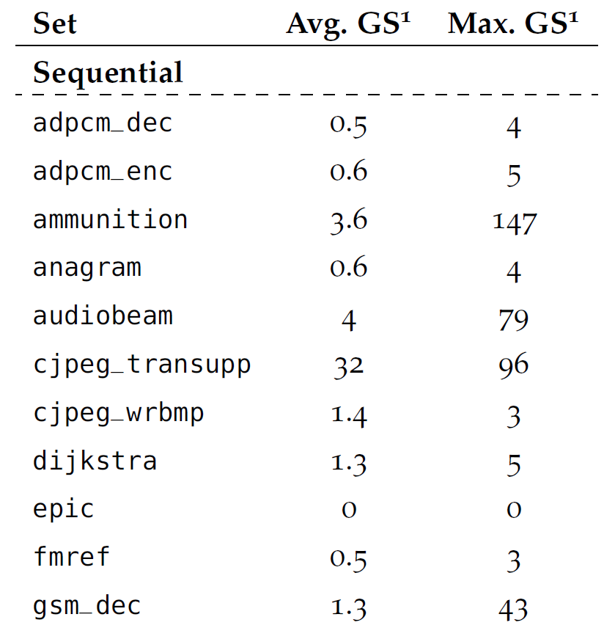
μScramble
Security Evaluation
Coverage Analysis
1000 firmware variants per benchmark
Harvest ROP gadgets
Max avg. gadget survival rate: 10.15%
Complicating Attacker Factors
Payload length
Firmware complexity
Fine-Grained Randomization
Notes:
When it comes to the security of uScramble I performed a coverage analysis where I generated 1000 firmware variants for each benchmark and harvested their ROP gadgets.
I then determined their gadget survival rates, which indicates in how many other firmware images a given gadget lives at the same address, and found that the maximum average gadget survival rate was 10.15%.
This is pretty good at reducing attack scalability considering code reuse attacks are complicated by factors such as payload length and firmware complexity as well as the fine-grained nature of uScramble’s randomization.

Slide 60
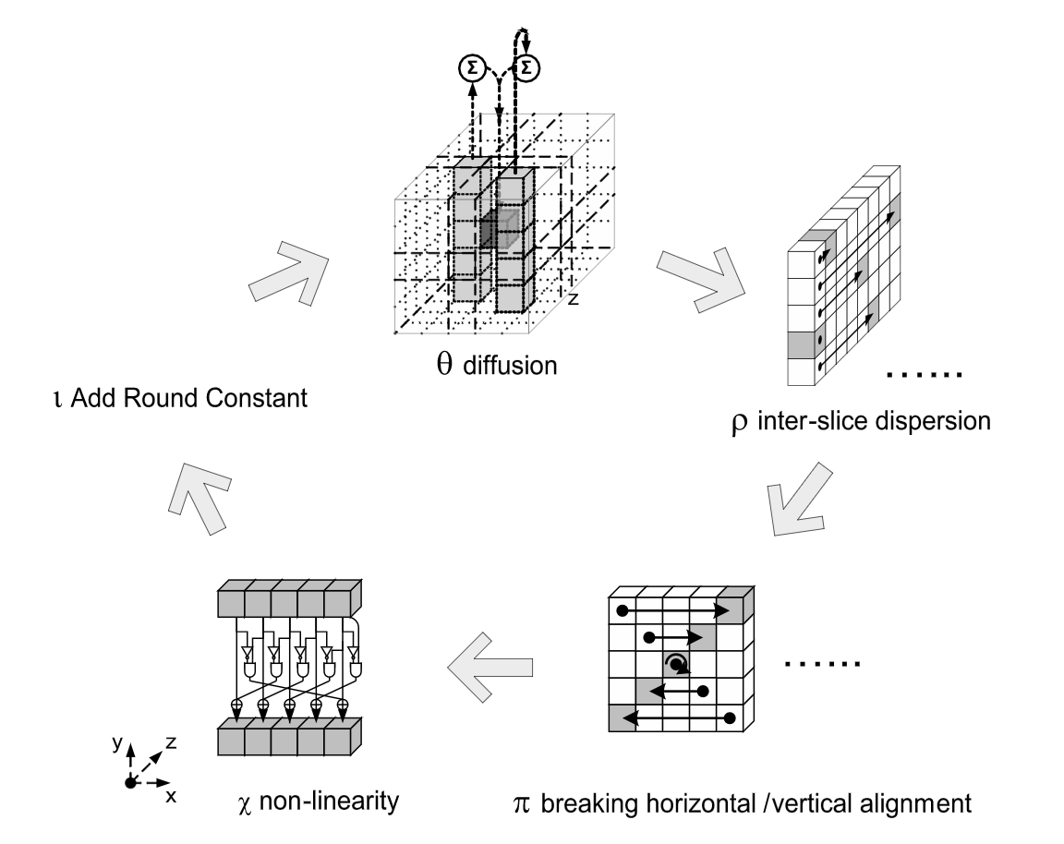
μRNG
Security Evaluation
Keccak is well-analyzed
Passive State Recovery Attacks
Reseed at least every 1GB of output
well within 32GB bound*
No ‘Boot Time Entropy Hole’
All initial entropy instantly available
* Sponge-based pseudo-random number generators - Guido Bertoni et al. (2010)
Notes:
Finally, for uRNG we know Keccak is well-analyzed in terms of cryptanalysis as it is the core of SHA3 among other things.
When it comes to state recovery attacks we ensured uRNG reseeds at least every 1 GB of output to meet the required 32 GB bound and while active attacks are out of scope here uRNG can be configured to reseed every 2 KB of output to meet this metric as well.
uRNG does not suffer from a so-called boot time entropy hole because all initial entropy is available at once in SRAM at very early boot which is a great plus point.

Slide 61
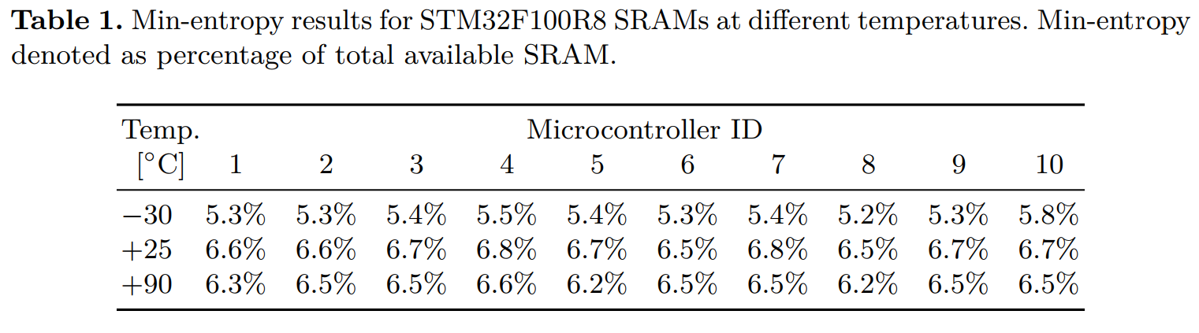
μRNG
Security Evaluation
SRAM Suitability Depends on Chip
Need Entropy ≥ 2 * security strength
Avg. Entropy: 5% of SRAM size*
Worst-case: 1.2% (100 bits) for PIC16F
Reality
SRAM slightly contaminated
Harvest in v. early boot & limit stack use
Memory Retention
Minimal at normal ambient temps
Clear loss in cold (-20C) for some chips
Full SRAM reset between power cycles
* Secure PRNG Seeding on Commercial Off-the-Shelf Microcontrollers - Van Herrewege et al. (2013)
Notes:
It is important to note, however, that the suitability of SRAM for RNG seeding depends on the chip. In our case we need at least two times as many bits of entropy as the desired security strength, which is quite feasible considering prior work has indicated that the average SRAM entropy is 5% of the total SRAM size. But there are some edge cases such as 1.2% (corresponding to 100 bits) for the PIC16F microcontrollers for example.
We also need to keep in mind that SRAM is slightly contaminated by the time it is used due to memory usage so we need to harvest it in very early boot and limit stack usage before that.
Finally there’s the risk of memory retention which has been found to be minimal at normal ambient temperatures but shows a clear loss of entropy in cold environments for some chips. To limit the danger of this it is recommended to do a full SRAM reset between power cycles.

Slide 62
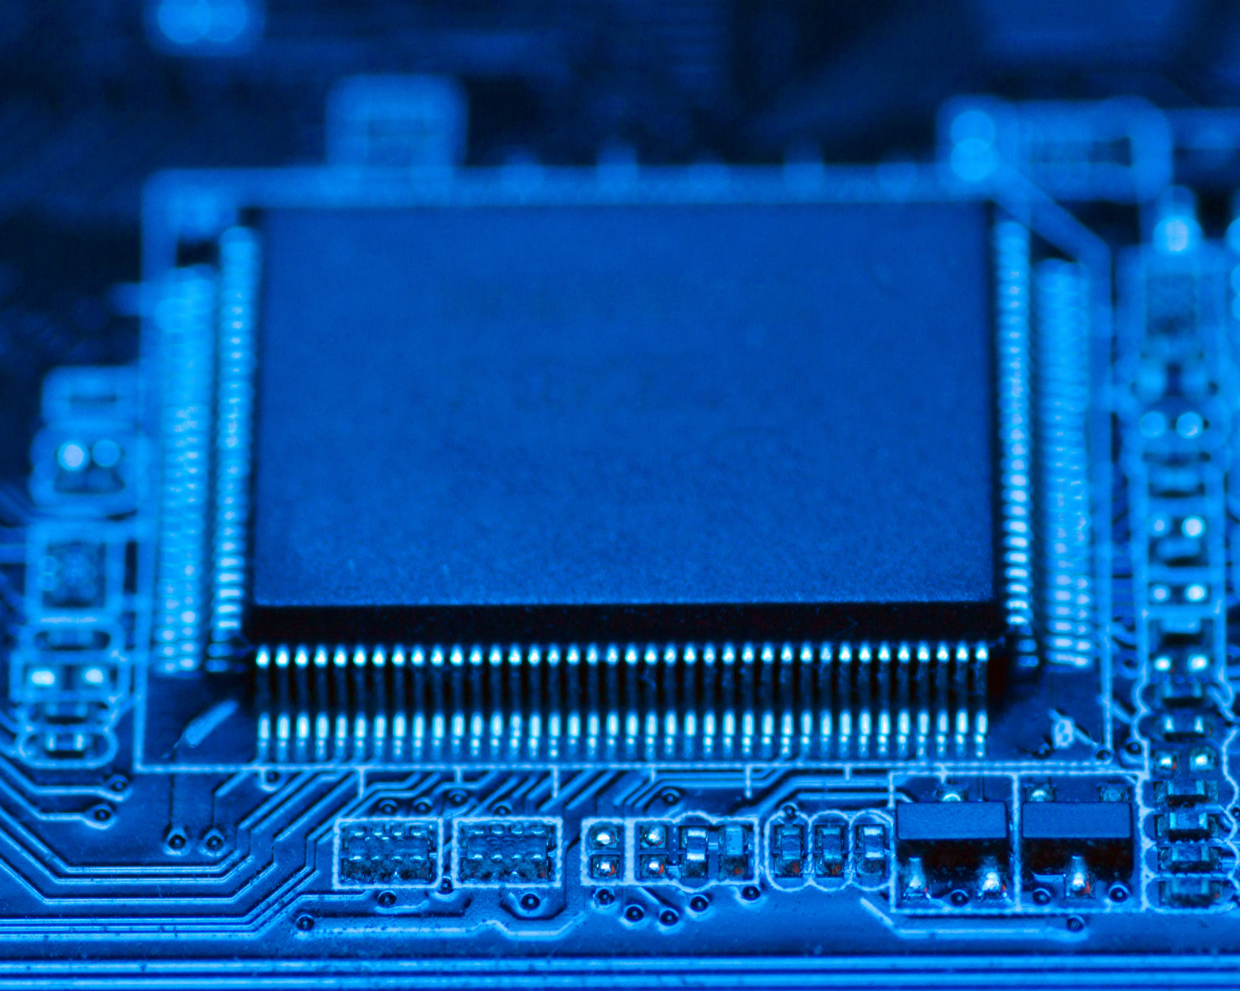
Limitations, Conclusions & Future Work
Notes:
And this brings us to the limitations, conclusions and future work.

Slide 63

μArmor Limitations
Platform
Harvard CPU or VNA with
hardware ESP
Attacker Model
Remote Control-Flow Hijacking Only
Diversification Relocation Frequency
Compile- / Update-Time Only
Diversification Coverage
Code Memory only
Notes:
uArmor is intended as a first step towards a better exploit mitigation situation in deeply embedded systems but is of course not perfect.
There’s limitations around the platform because without either a Harvard CPU or von Neumann one with hardware ESP we cannot provide ESP with reasonable overhead yet.
There’s also the attacker model which does not protect against local attackers or eg. data-flow attacks.
And finally the diversification approach is limited in frequency (because it is restricted to compile and update-times) and coverage because it only diversifies code memory.

Slide 64

Conclusions
Embedded memory Corruption issues warrant serious attention
Smallest of devices are connected
Unsafe languages are here to stay
Current state of embedded mitigations is terrible
Esp. in deeply embedded / RTOS
Not easily fixed either
μArmor is intended as small step forward
Notes:
So, in conclusion, embedded memory corruption issues warrant serious attention. Even the smallest of embedded systems are getting increasingly connected and unsafe languages are here to stay.
The current state of embedded mitigations is terrible, especially when it comes to deeply embedded / RTOS systems, a situation which is not easily fixed as we’ve seen.
Here uArmor is intended as a small step forward upon which we can build.

Slide 65



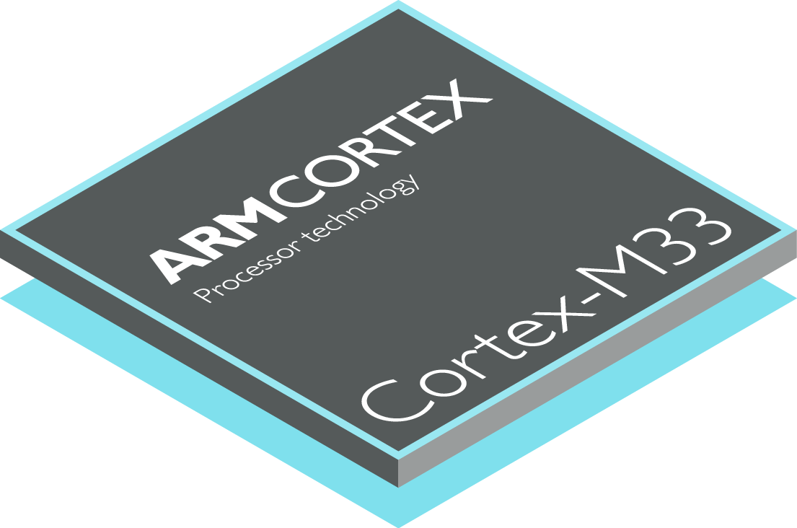

Future Work
Long Term
Embedded Safe Language Adoption
(Rust Embedded, Tock OS, etc.)
Secure & Scalable Patching
Short Term
Mitigation Baseline Adoption in RTOS
Hardware Dependency Support
Advanced Embedded Mitigations (CFI, XoM, etc.)
Notes:
With regards to future work I think there are two trajectories: a long term and a short term one.
In the long term we need to get serious about embedded safe language adoption, the rust embedded and Tock OS projects have shown some promise here already.
We also need widespread adoption of secure and scalable patching solutions.
But while we are working on the long term we need short term solutions as well. The first of which is adoption of the exploit mitigation baseline I outlined for deeply embedded / RTOS systems, something Fuchsia seems to be taking seriously.
We also need to move towards increased hardware dependency support for these mitigations, something we can see in modern ARM chips.
And finally we need to explore our options with advanced mitigations for embedded systems such as control-flow integrity and execute-only memory.

Slide 66

Questions?
🐦 @s4mvartaka
✉ j.wetzels@midnightbluelabs.com
Notes:
And that’s it. If there are any questions I’d be glad to answer them now :)

